Slide 1
Democracy Prevention
U.S. Foreign Policy and the Arab Uprisings
cLASS-MEETING NOVEMBER 27, Anna viden anna.viden@fsv.cuni.cz

Slide 2
Media
http://arabist.net/blog/2012/6/7/stacher-and-brownlee-on-democracy-prevention.html
http://www.atlanticcouncil.org/events/past-events/getting-us-policy-right-in-egypt-where-does-democracy-promotion-fit

Slide 3
Jeanette Feghali alias Sabah; Diva of Music
https://www.youtube.com/watch?v=YoYt86F04w4
https://www.youtube.com/watch?v=qrfnA45sO30
https://www.youtube.com/watch?v=6f9zlN4eFX8
Sabah (Arabic: صباح) (born Jeanette Feghali on November 10, 1927), Wadi Chahrour, Lebanon was a Lebanese singer and actress whose career stretched from 1943 to 2014

Slide 4
Jason Brownlee
Latest book, Democracy Prevention: The Politics of the U.S.-Egyptian Alliance looks at why, since 1973, the United States has helped reproduce authoritarianism in Egypt. Information on his other publications can be found here. The focus of his current research is violence during political transitions and U.S.-Egyptian relations.
Has discussed Democracy Prevention in interviews for Jadaliyya, the Project on Middle East Political Science (POMEPS), theNortheast Ohio Consortium for Middle East Studies (NOCMES), and the New Books in Middle Eastern Studies podcast. The book has been reviewed by Middle East Report and the New Left Project.
Associate professor of Government and
Middle Eastern Studies at the University of Texas
Focus on comparative politics

Slide 5
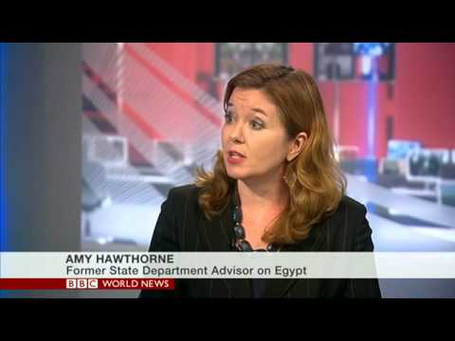
http://www.atlanticcouncil.org/news/in-the-news/hawthorne-on-effect-of-isis-on-us-egypt-relations
http://www.atlanticcouncil.org/blogs/menasource/everything-you-need-to-know-about-the-us-egypt-aid-relationship
http://www.atlanticcouncil.org/blogs/egyptsource/top-news-egypt-minister-warns-of-lethal-force-ahead-of-november-28-protests
http://www.atlanticcouncil.org/blogs/egyptsource/where-is-egypt-s-maspero-youth-union-now
http://www.atlanticcouncil.org/blogs/egyptsource/it-s-time-the-egyptian-government-made-peace-with-human-rights
Amy Hawthorne
Resident Senior Fellow, Rafik Hariri Center for the Middle East
Focus: Arab transitions, Democracy and human rights, US policy in the Middle
Special expertise: Egypt

Slide 6
Was a research director and senior associate at the Carnegie Middle East Center in Beirut
Focus: changing dynamics of political participation in the Arab world and the role of Islamist movements in Arab politics.
Co-author, with Nathan J. Brown, of Between Religion and Politics (2010), and author of The Arab Future–Contemporary Debates on Democracy, Political Islam, and Resistance, (2010 in Arabic).
The Middle East Advisory Council of Human Rights Watch, and the boards of Crisis International and the Arab Council for Social Science.
Contributes articles in Arabic and English to various academic journals and writes a bi-monthly op-ed for the leading Arab daily al-Hayat.
Amr Hamzawy
Joined the Department of Public Policy and Administration at the American University in Cairo in 2011
Former member of parliament, former member of the National Salvation Front, and founder of the Freedom Egypt Party.
http://carnegie-mec.org/2011/02/25/what-egypt-must-do-during-transition/b3cc
http://carnegie-mec.org/2011/02/01/egypt-at-crucial-moment-road-map-toward-democracy/b3ch

Slide 7
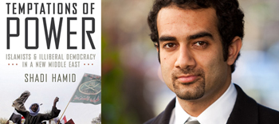
http://www.brookings.edu/experts/hamids
Shadi Hamid
Fellow with the Project on U.S. Relations with the Islamic World in the Center for Middle East Policy,
author of Temptations of Power: Islamists and Illiberal Democracy in a New Middle East (Oxford University Press, 2014).
Prior to joining Brookings, Hamid was director of research at the Project on Middle East Democracy (POMED) and a Hewlett Fellow at Stanford University's Center on Democracy, Development, and the Rule of Law. Hamid is currently vice chair of POMED, a member of the World Bank’s MENA Advisory Panel and a contributing writer for The Atlantic.

Slide 8
Waves of democracy
“The term, “waves of democratization,” popularized by Huntington (1991), can be conceptualized in at least three ways: as rises in the global level of democracy, as periods of positive net transitions to democracy, and as linked sets of transitions to democracy. Each of these approaches to the concept carries distinct theoretical implications and generates somewhat different historical patterns”.
Charles Kurzman, “Waves of democratization”, Studies in Comparative International Development, Spring 2008, Vol. 33, Issue 1, pp.42-64.

Slide 9
Waves of democratization
First wave (1828-1926). This wave had its roots in the American and French revolutions. Two criteria marked this first development: 50% of males were eligible to vote and a responsible executive who had to maintain the support of a majority of voters or of an elected parliament.
First reverse wave (1922-42). This period was characterized by a shift away from democracy toward traditional authoritarian or new ideologically-driven, mass-based totalitarian regimes.
Second wave (1943-62). Allied occupation post-WWII encouraged democratization in former Axis powers, with exception of Soviet influence in Hungary and Czechoslovakia. Meanwhile, the beginning of the end of Western colonial rule produced a number of new states with democratic tendencies.

Slide 10
The Third Wave
Second reverse wave (1958-75). Especially in Latin America, political development in the early 1960s took on an authoritarian cast. The decolonization of Africa led to the largest multiplication of authoritarian governments in history. One third of the working democracies in 1958 had become authoritarian by the 1970s.
Third wave (1974-). Democratic regimes start to replace authoritarian and considerable liberalization occurs in authoritarian regimes. This takes place in every region of the world and is intensified by the fall of Communism.
This analysis suggests a two-steps forward, one-step back record of success for democratization
Samuel Huntington, The Third Wave (1991)1-30.

Slide 11
Brownlee and the argument of democracy prevention
Clinton administration: “Extraordinary renditions”: transport to Egypt for interrogation simultaneous with pro-democracy rhetoric
George W. Bush administration: Freedom agenda: expansion of extraordinary renditions; intensification of military support that coincides with pro-democracy rhetoric
Obama Administration: Continuity of foreign policy agenda; damage control to maintain strategic cooperation; no intent to support democratic transition; intent to maintain stability
Obama Speech on February 11: “Late in the game”
No proactive democracy support

Slide 12
Obama February 11, 2011 Speech
“The military has served patriotically and responsibly as a caretaker to the state, and will now have to ensure a transition that is credible in the eyes of the Egyptian people. That means protecting the rights of Egypt’s citizens, lifting the emergency law, revising the constitution and other laws to make this change irreversible, and laying out a clear path to elections that are fair and free. Above all, this transition must bring all of Egypt’s voices to the table. For the spirit of peaceful protest and perseverance that the Egyptian people have shown can serve as a powerful wind at the back of this change”.
“The United States will continue to be a friend and partner to Egypt. We stand ready to provide whatever assistance is necessary -- and asked for -- to pursue a credible transition to a democracy. I’m also confident that the same ingenuity and entrepreneurial spirit that the young people of Egypt have shown in recent days can be harnessed to create new opportunity -- jobs and businesses that allow the extraordinary potential of this generation to take flight. And I know that a democratic Egypt can advance its role of responsible leadership not only in the region but around the world”.

Slide 13
Jason Brownlee cont.
U.S. “Fine” with turning power over to the generals
Brownlee’s argument will help us understand the post-Mubarak U.S.-Egyptian relations
Investment in strategic cooperation and need to maintain this circumscribes all other aspects of U.S. Egypt relations.
Periodic criticism from both parties

Slide 14
Amy Hawthorne
Hawthorne: need to establish consensus based political system in Egypt to stabilize the country; this is directly related to U.S. core national interests
U.S-Egypt strategic relationship a “transactional relationship”
U.S. has no significant influence on Egypt
U.S. has less leverage than what is generally understood
U.S. role in Egypt is complex
Linkage
Forms of U.S. influence: military cooperation; economic engagement (stabilize Egypt’s economy); democratic legitimation of Egypt’s political system

Slide 15
Amy Hawthorne cont.
“Democratic leap for Egypt”: stamp of approval indirect leverage
Linkage: American soft power: connection with Egyptian counter-parts; not possible to create a strong linkage; constituency of young Egyptians that are interested to engage with the USA.
Need for the U.S. to focus on the “underlying framework of human rights” not necessarily on elections
Electorally dominated strategies
Since 2011 U.S. government focused on road-maps expected to lead to democracy
Constitution drafting a source for instability
Egyptians want to have a stake in the evolution of their countries; long-term issues that the U.S. should focus on.

Slide 16
Amy Hawthorne
Obama Administration focuses on multilateral approaches
Policy recommendations: call for withholding of democratic legitimation while continuing the funding of the Egyptian government
“Updating Egypt military aid”: military aid serves the strategic purposes of the U.S. in Egypt; does not have anything to do with democracy promotion
Security threat in Egypt has changed
Security threats cooperation with Egypt a diplomatic challenge
Congress should play a larger role in emphasizing human rights/democracy aspects of military aid
U.S. goals: to maintain a relationship with whoever is in power

Slide 17
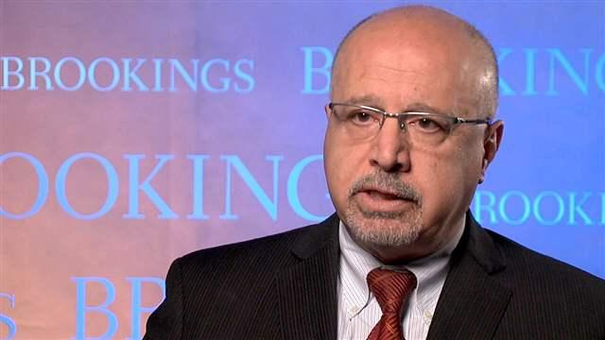
The Stakes: America and the Middle East (Westview Press, 2003; Power and Leadership in International Bargaining: The Path to the Camp David Accords (1990); International Organizations and Ethnic Conflict, ed. with Milton Esman (1995); Identity and Foreign Policy in the Middle East, ed. with Michael Barnett (2002), The Sadat Lectures: Words and Images on Peace, 1997-2008, ed. (2010), The Peace Puzzle: America’s Quest for Arab-Israeli Peace, 1989-2011,co-authored with Dan Kurtzer, et al. (2013), The World Through Arab Eyes: Arab Public Opinion and the Reshaping of the Middle East (2013)
Has been a principal investigator in the annual Arab Public Opinion Survey, conducted since 2002 in six Arab countries.
Anwar Sadat Professor for Peace and Development at the University of Maryland, College Park
Non-resident senior fellow at the Brookings Institution. Has taught at Cornell University, the Ohio State University, the University of Southern California, Princeton University, Columbia University, Swarthmore College, and the University of California at Berkeley, where he received his doctorate in political science
Has held government positions.

Slide 18
Shibley Telhami
Divided tendencies; divided discourses
“There are things that we don’t like”
Democracy is a U.S. interest; it is long-term
Military: Core constitutional ally in Egypt; “the military is inherently incapable of democratic reform”
It is key to locate the idea of a democratic Egypt within U.S. core interests
There is a focus on “Immediate strategic priorities”: by choice and by necessity
Strategic issues of regional character key

Slide 19
Shibley Telhami
“The military need to realize that the environment in Egypt is fluid”.
The military is “responsive” to the international community; they are even more responsive to the people of Egypt
The game-changer in Egypt is that the people are bound to question
“People expect actions from words”.

Slide 20
Public Opinion
Strategic selection of alliances
Source of attitudes: advancement of American imperial interests
Reason for resentment: issues related to counterterrorism strategies

Slide 21
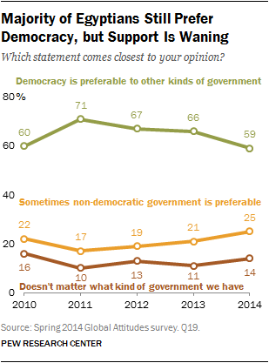
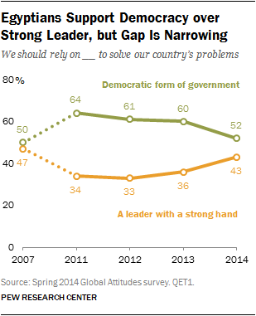
Roughly six-in-ten Egyptians (59%) believe that democracy is preferable to any other kind of government, with a quarter saying in some circumstances a non-democratic form of government is preferable, and 14% saying the type of government does not matter.
http://www.pewglobal.org/2014/05/22/chapter-3-democratic-values-in-egypt/

Slide 22
There is a significant gender gap on preference for democracy. Nearly seven-in-ten Egyptian men (67%) think that democracy is preferable, while only around half of women (51%) agree. Roughly three-in-ten Egyptian women (29%) say that non-democratic government is preferable in some circumstances, with a further 18% saying that the type of government does not matter. Only 21% of Egyptian men think not having a democracy can be preferable and an additional 11% think it does not matter.

Slide 23
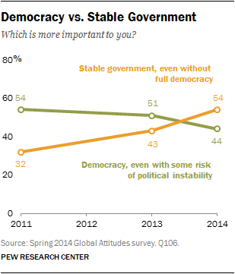
When asked about the tradeoff between democracy and stability, a narrow majority of Egyptians (54%) now say that having a stable government is more important, even if there is a risk it will not be fully democratic. Just 44% believe it is more important to have a democratic government, even if there is some risk of political instability. This is greatly changed from 2011, when 54% of Egyptians thought democracy was more important, compared with the 32% who prioritized stability. Just in the last year, support for a stable government is up 11 percentage points, while the percentage preferring democracy is down seven points.

Slide 24
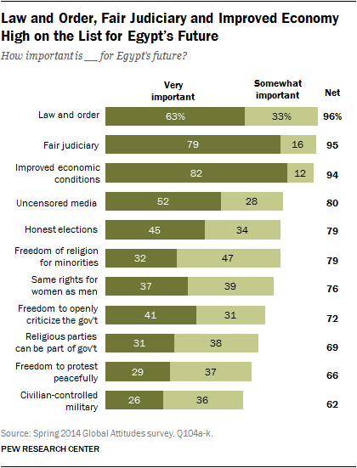
Majorities in Egypt say that values commonly associated with democracy are important for Egypt’s future. However, strong support for these values ranges from 79% who say that a fair judiciary is very important for Egypt’s future to just 26% who say that a civilian controlled military is very important.
Overall, 82% say that improved economic conditions are very important for Egypt’s future. And nearly eight-in-ten (79%) say that a judicial system that treats everyone in the same way is very important. Similarly, 63% of Egyptians say law and order is critically important to their country’s future.
Less than four-in-ten say having the same rights for men and women (37%), freedom of religion for religious minorities such as Copts (32%), and allowing religious parties to be part of the government (31%) are very important. The importance of having religious parties in government has dropped 16 percentage points since 2013, the steepest drop among any of the democratic values asked.
Fewer Egyptians think that an uncensored media (52% very important), honest elections (45%), and freedom to openly criticize the government (41%) are essential for Egypt’s future. And support for these fundamental democratic rights has diminished in the last year.

Slide 25
Questions
Do you think it is possible for the United States to consolidate democracy promotion with stability promotion. If so, how? If not why?
Should the United States pursue stability promotion at all costs?
What do you think is the most urgent political issue in Egypt?
How do you think Egypt will move forward? What do you think the U.S. should do to affect the outcome? Should the U.S have a stake in the evolution of Egypt? Why? Why not?.

