Slide 1
Seminar 1: BoP identities & 2-period model (exercises)
Alessandro Chiari
(based on M. Kábrt‘s presentation from 2021)
International Macroeconomics
FSV UK, 19th February 2024

Slide 2
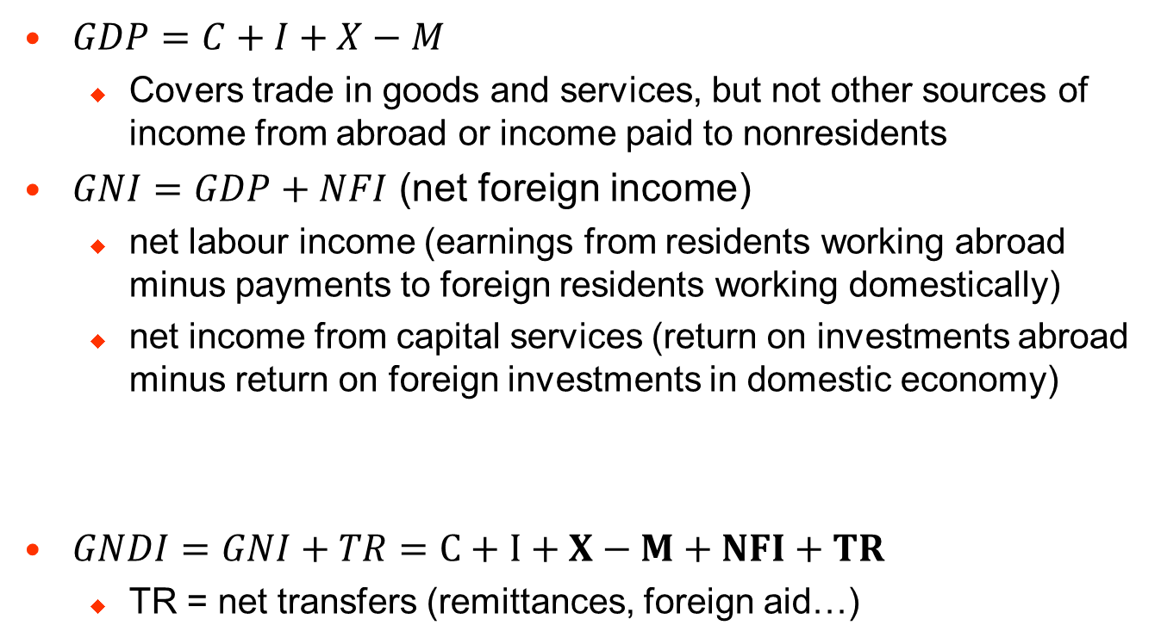
Foreign balance in National Accounts
$GDP=C+I+X−M$
Covers trade in goods and services, but not other sources of income from abroad or income paid to nonresidents
$GNI=GDP+NFI$ (net foreign income)
net labour income (earnings from residents working abroad minus payments to foreign residents working domestically)
net income from capital services (return on investments abroad minus return on foreign investments in domestic economy)
$GNDI=GNI+TR=C+I+X−M+NFI+TR$
TR = net transfers (remittances, foreign aid…)
CA
Notes:
GNI = domestic and foreign expenditure on the goods and services generated by a country’s factors of production
GDP = domestic and foreign expenditure on the goods and services generated within a country’s borders

Slide 3
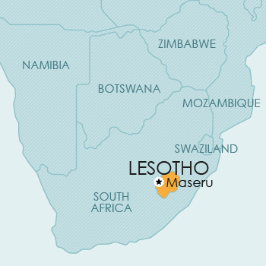
Quiz: Can you explain the difference between GDP and GNI in these countries?
USD bn, 2015 | GDP | GNI | GDP/GNI
Czechia | 188.0 | 175.1 | 107%
Ireland | 291.5 | 224.1 | 130%
Kuwait | 114.6 | 127.3 | 90%
Lesotho | 2.4 | 2.7 | 89%

Slide 4
Balance of Payments accounts
BoP accounts keep track of a country’s payments to (debit) and its receipts from foreigners (credit)
Current account (goods and services trade, primary income (=NFI), secondary income (=TR))
The financial account records international purchases and sales of financial assets (FDI, portfolio investments…)
Other activities that result in transfer of wealth between countries are recorded in the capital account (sales of copyrights, emission allowances, debt forgiveness…)
BoP encompasses both the current account and the transactions that finance it
Double-entry book-keeping: each transaction is recorded as a credit and as a debit
Notes:
CA doesn’t capture all transactions between residents and non-residents. BoP is a different lens to look at open-economy macro than National Accounts.

Slide 5
Examples of paired transactions
Domestic firm exported cars worth $1,000k and extended the foreign buyer a short-term trade credit payable in the next year
In a privatisation, the government sold its 49% stake in a domestic company worth $2,000k to a foreign entity. The money was paid to the government’s account at the CNB
Domestic investment fund bought US Treasuries worth $3,000k
Domestic government provided financial aid abroad worth $4,000k
A foreign owner of a domestic company paid herself a dividend of $5,000k
Current account | Credit (+) | Debit (-)
Goods | $1,000k
Services
Primary income |  | $5,000k
Secondary income |  | $4,000k
Financial account | Net change of foreign assets (+) | Net change of foreign liabilities (-)
Direct investment |  | +$2,000k
Portfolio investment | +$3,000k
Other investment | +$1,000k -$3,000k -$5,000k
Reserve assets | +$2,000k -$4,000k
Notes:
For every transaction, there is a credit and debit entry. However, both can appear on the same side of the BoP identity (i.e. both can be on the current account, or both on the financial account)
Source: Mandel, M and Durcakova, J. (2016)

Slide 6
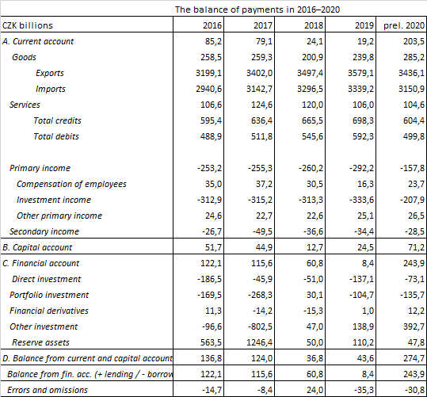
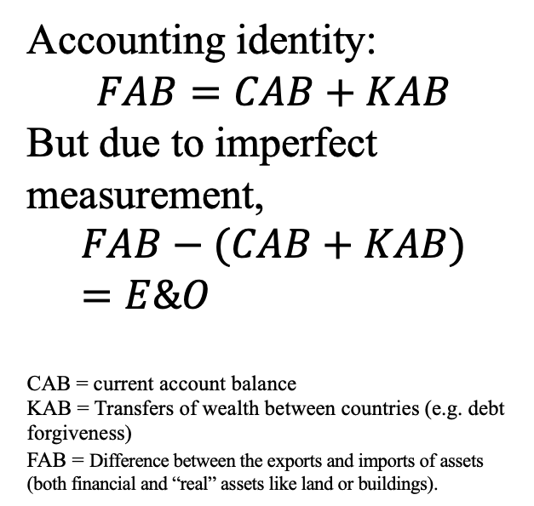
Example – CZ BoP in 2016-2020
Accounting identity:
$$FAB=CAB+KAB$$
But due to imperfect measurement,
$$FAB−(CAB+KAB)=E\&O$$
CAB = current account balance
KAB = Transfers of wealth between countries (e.g. debt forgiveness)
FAB = Difference between the exports and imports of assets (both financial and “real” assets like land or buildings).
FA items record the difference between net acquisition of assets abroad (BoP debits) and net incurrence of liabilities (BoP credits).
FAB>0 capital outflow
FAB<0 capital inflow
Source: Czech National Bank

Slide 7
Problem 1: The basic 2-period model
Consider a simple 2-period model without investment (the pure endowment model). The representative individual maximizes her utility represented by
An exogenous world interest rate r is given and each individual receives income of Y₁ and Y₂ in respective periods.
a) Derive the budget constraint, the Euler equation, and compute the optimal consumption path.
b) Assume that Y₁ = 80, Y₂ = 110, β= 0.8 and r = 10%. Compute the consumption path, current accounts for both periods and net exports. Show graphically.
c) Show analytically and graphically how the lifetime utility and consumption in both periods depend on the interest rate r.
(1)

Slide 8
Problem 1 (a)
The intertemporal ("across time") budget constraint is the present discounted value of consumption expenditures (C₁, C₂) which must be equal to the present discounted value of income (Y₁ and Y₂), that is:
To get the Euler equation (characterising an intertemporal optimal consumption choice), we start by expressing C₂ from (2) and substituting it into (1):
(2) Budget constraint
C₂
(3)

Slide 9
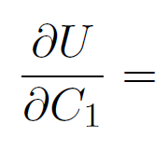
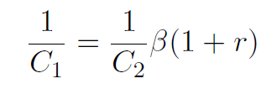
Problem 1 (a)
Such substitution reduces the optimisation problem to an unconstrained problem. We can simply differentiate (3) with respect to C₁ and set it equal to 0:
More generally,
(3)
(4) Euler equation
Marginal utility of consuming in t=1 = Marginal utility of saving in t=1

Slide 10
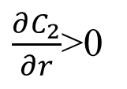
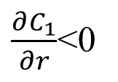
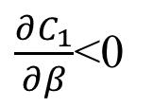
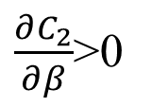
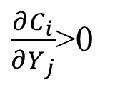
Problem 1 (a)
Expressing C₁ and C₂ from (4) (Euler equation) and plugging into the budget constraint (2), we find the optimal consumption schedules:
It’s easy to show that:
(5)
(6)
$\frac{∂C_{1}}{∂β}$<0
$\frac{∂C_{2}}{∂β}$>0
$\frac{∂C_{1}}{∂r}$<0
$\frac{∂C_{2}}{∂r}$>0
$\frac{∂C_{i}}{∂Y_{j}}$>0

Slide 11
Problem 1 (b)
Assume that Y₁ = 80, Y₂ = 110, β= 0.8 and r = 10%. Compute C₁, C_{2,} NX₁, NX₂, CA₁, CA₂
From (5) and (6), C₁ =100, C₂ =88
Net exports are straightforward:
To compute current account balances, recall that
Since there is no initial bond endowment (B₁=0),
(7)

Slide 12
Problem 1 (b)
What about CA₂? We need to know B₂ …
Recall the one-period budget constraint
Plugging into (7),
And finally,
(8)

Slide 13
Observations…
A country with low initial income Y₁ relative to higher income in the second period Y₂ engages in intertemporal trade to smooth consumption over time (C₁>Y₁)
A current account deficit means that the country borrows, while a surplus means that the country lends resources abroad
The sum of current accounts will always be equal to zero, because the assumption of two periods forces the households to run balanced current account overall
To smooth consumption, the country borrows funds internationally (NX₁<0) and repays them in the second period (NX₂>0) with the interest payment of 10% (22 = 20 + 0.1x20)
Generally, in the 2-period model, countries with high (low) current income relative to future income, will tend to run CA surpluses (deficits) to smooth consumption over time. It is not viewed as an imbalance.

Slide 14
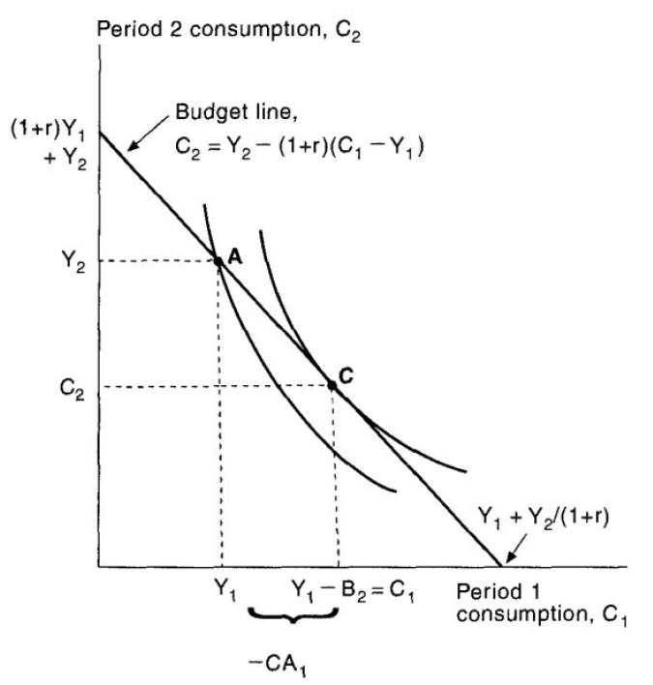
Graphical representation
IT IS IMPOSSIBLE TO IMPORT FOREIGN CAPITAL WITHOUT A CA DEFICIT

Slide 15
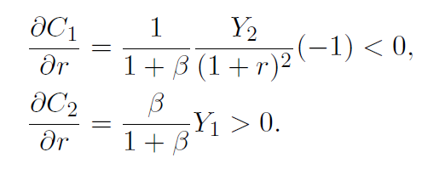
Problem 1 (c)
Show analytically and graphically how the lifetime utility and consumption in each period depends on the interest rate r.
Differentiating optimal consumption schedules (5) and (6) with r
But the impact on overall lifetime utility is ambiguous
…and depends on the level of the interest rate r and the time preference of the household (β) and also by the initial position of the household (a lender or a borrower).

Slide 16
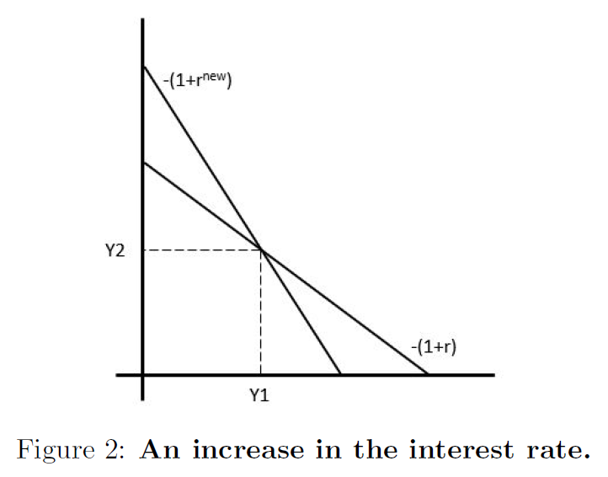
Problem 1 (c)
An increase in the interest rate will cause a clockwise rotation in the budget line
Q: can we tell from the graph that the overall utility effects are ambiguous?

