Slide 1
Financial dilemmas of SMEs in developing countries
YAO WANG

Slide 2
Why SMEs
The Biggest Obstacles SMEs Faced in Developing Countries
Current Research- Chinese SMEs financing dilemma
Direction
Value of Research
Hypothesis
Methodology
Data

Slide 3
WHY SMEs
SMEs are drivers of economic growth and job creation in developing countries.
eg: 47 million SMEs in China, occupied over 98% of all enterprises, provide 85% of new job vacancies, contributes 59% of GDP.
It is paramount to determine the factors that hinder their growth.
More importantly, figure out the solutions. (current research)

Slide 4
OBJECTIVES
Find out the obstacles that SMEs faced, regards developing countries as whole, sort out the commons.
Relationships between the chosen variables of the firms with the chosen obstacles.

Slide 5
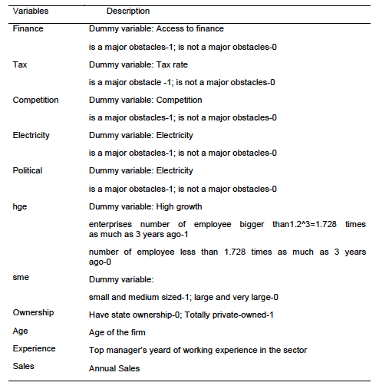

Slide 7
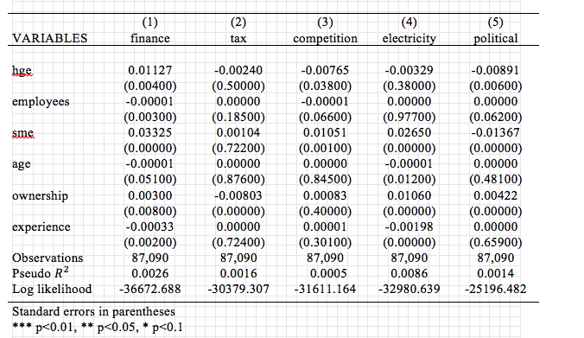
Marginal Effect

Slide 8
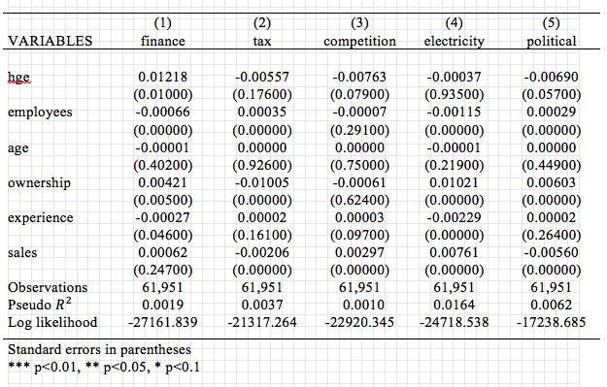

Slide 9
Result
Access to finance is the biggest obstacle among the chosen five obstacles.
The results show that high growth firms have a positive relationship with the probability of perceiving finance as the biggest obstacle, which indicates that high growth firms have higher demand of funds than those slower growth firms. When the firm is growing, access appears to be less of a problem.
Top managers’ working experience also has a negative relationship with “access to finance”, which emphasises the importance of experienced managers to SMEs.
State-owned firms have fewer financing problems than private ones due to their guarantees from the governments.
Size and age are negatively correlated with the severe level of the financing problem which implies that with the increasing size and age of the firm, it will be less likely to perceive access to finance as a severer problem. After determining the internal factors affecting the access to finance of SMEs, the external factors are revealed. The external factors can be ascribed to the imperfections of the financial system, which includes asymmetric information between banks and SMEs, and a lack of institutional support for SMEs.

Slide 10
Data
World Bank Enterprise Survey
The survey is a firm-level survey conducted through 130,000 firms in 135 countries, of which 119 are conducted through standard methodology.
The data is collected from face-to-face interviews with top managers and business owners by private contractor on behalf of the World Bank. Since 2002, over 73,000 interviewees have joined the survey.

Slide 11
Policy Implications
First and foremost, an advanced sophisticated credit warranty system of SMEs should be established so as to provide institutional support for SMEs and to eliminate the asymmetric information between banks and SMEs as well.
In spite of this, a systematic and restricted rule of credit rating which focuses on SMEs should be set up immediately.
Meanwhile, interest rate deregulations are suggested to be implemented in the credit constraints that SMEs face when applying for a bank loan.
Last but not the least, in terms of the principles of law, the authorities should take immediate actions in regulating and strengthening informal financing. Another effective way is to change the informal financing into formal commercial banks as the evidence from Chinese innovative e-banking.

Slide 12
Current Research
Now, to figure out whether the entry of private capital banks will change the situation. The government has recently opened the banking industry to private sector following the resolution of 12th National People's Congress & Chinese People's Political Consultative Conference which was held in March 2014.

Slide 13
HYPOTHESIS
Could access of SMEs to credit be improved by a more vigorous entry of private banks into the financial industry?

Slide 14
METHODOLOGY
1. From the asymmetric information perspective, analyzing the financial dilemma of Chinese SMEs.
(Both demand and supply side)
Demand: bank ownership
Supply: SME themselves
2. From the private banks, analyzing the Innovation of SME’s bank lending methods in China: evidence of Ali internet banking and Minsheng bank 2.0 model.

Slide 15
DATA
A panel data from Chinese University of Hong Kong will be used for testing model. A stratified survey dataset on Chinese private enterprises which compromises 3837 observations and covering 31 regions in China.
World Bank Enterprises Survey

