Slide 1
Reborn of Czechoslovakia 1945 – 1948
prof. PhDr. Michal Stehlík, Ph.D.

Slide 2
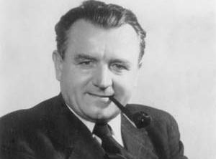
Main steps
After WWII
New State Programme
Political system
Economical situation
Countryside
National policy
Germans
Slovaks
International Situation
Communist Party
February 1948
USSR - Stalin

Slide 3
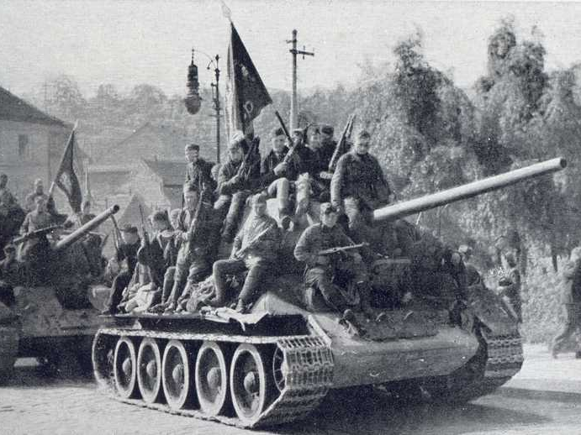
After WWII
Society after repressions – many intellectuals and people from Czech elites (schools, culture, army, state administration) were executed
Hope for a new justice world – socialisms as an alternative
Scepticism against the 1st Czechoslovak Republic

Slide 4
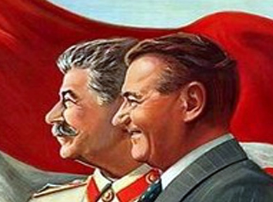
After WWII
Political agreement between the exil leaders in London and Moscow
President Beneš, Prime minister Fierlinger
Without involvement of the Czech „home“ resistance
Negotiation in Moscow 1943, 1945

Slide 5
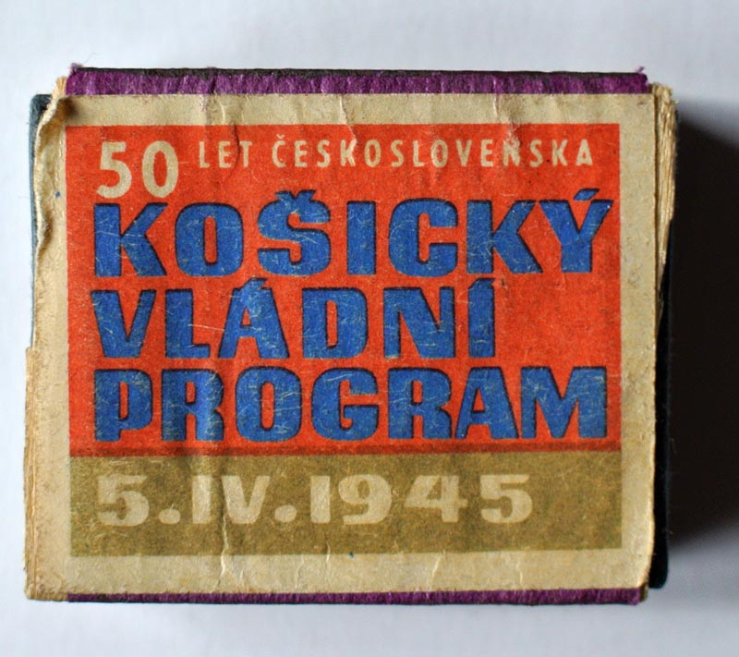
New State Programme – Košice 1945
President Beneš – from London to Moscow – from Moscow to Czechoslovakia
Programme as a basic material from Communist Party
Repressions against Germans, Hungarians, Nobility, War criminals
Nationalisation of banks, industry, mines…
New political system – National Front – limited number of political parties
National commitees as a basic stone of state organisation – new forms of organisation
Landed reform – Confiscations and distributions

Slide 6
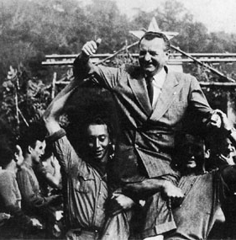
Political system
NATIONAL FRONT
Only 4 official political parties in Czech lands and really only 2 in Slovakia
Without continuity with the 1st Czechoslovak Republic
Revolutionary Parliament – Decrees of President Beneš
Elections 1946

Slide 7
Political System
Czech lands
Communist Party
Czech People´s Party (mostly Catholic)
Social Democracy
National Socialists
Slovakia
Democratic Party
Slovak Communist Party

Slide 8
Elections 1946
Communist Party as a strongest subject in Czech lands – more than 40 %
In Slovakia only 30 % – Slovak Democratic Party has 70 %
Prime Minister Klement Gottwald
Ministries for KSČ – Information, Agriculture, Interior
National Front – president only as a symbolic person

Slide 9
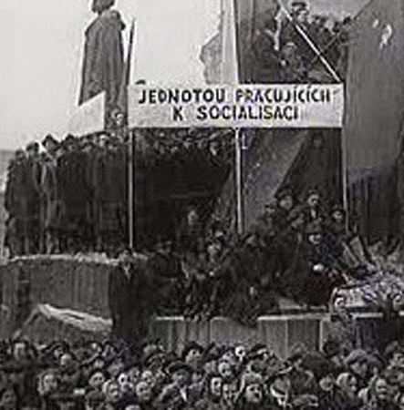
Economy
Stronger role of State – scepticism against liberal economical system
Socialism
Property of Nobility and Germans…
Confiscations and Distribution
Economical problems after WWII

Slide 10
Countryside
Confiscation of the German property
Distribution of this property to many Czech people
Without experiences with farming, glass industry, fabric industry
Problem in the Czech countryside
Success of the Communist Party – political strategy – new position instead of Agrarian Party

Slide 11
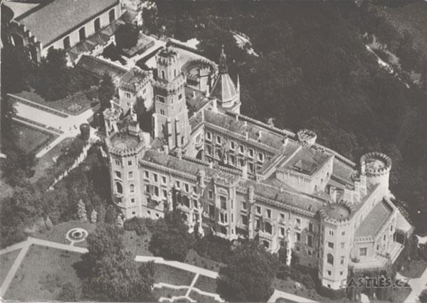
Confiscations as a problem after 1945
Against Germans and Nobility…
Lex Schwarzenberg
Problems with Liechtensteins
International capital – Compensations

Slide 12
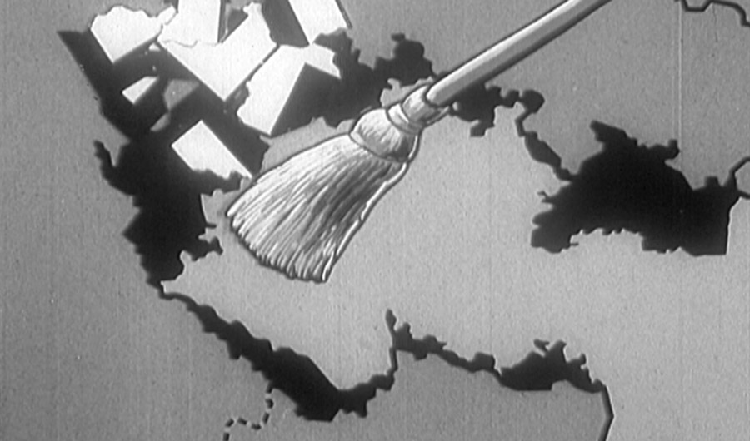
National Policy
Transfer of Germans – 3 milion of People
Problem with Slovaks
Hungarians and plans of transfer or population´s change between Hungary and Czechoslovakia
Remigration – Repatriation
End of multinational state…

Slide 13
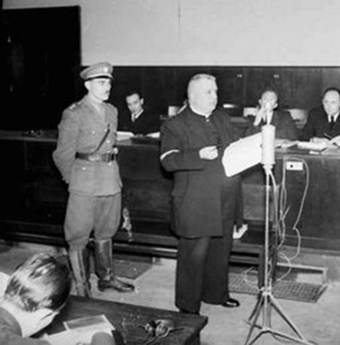
National Policy
Transfer of Germans
“ Wild transfer“, many murders. Executions…
“ Official transfer“ – with some rules…
Agreement with the USSR, GB, USA, France…
Slovaks
Execution of President Tiso
Failure of communist policy

Slide 14
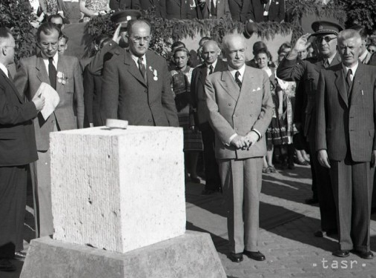
National Policy - Slovakia
Bad relations after 1945. Tradition of independent Slovak state 1939-1945
Slovak communists prefer „National Policy“ – independent Slovak organs in Czechoslovakia – Slovak National Counsel – support from the Czech communists
Change after Elections in 1946
Centralisation

Slide 15
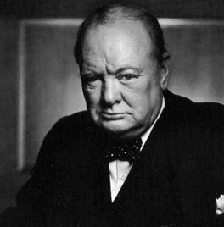
International Situation
New role of the USSR – world power – east Europe under Stalin´s Policy – Poland, Hungary, part of Germany, Czechoslovakia
Loss of Carpathian Russia as a part of Czechoslovakia
Speech of Winston Churchill in Fulton – March 1946 – Iron Curtain
Crisis – Berlin, Germany, Marshall Plan 1947

Slide 16
Marshall Plan 1947
Economical Support for Europe from the USA
USSR and Stalin against this support
First steps of Czechoslovakia – The government agree with participation of CSR.
After negotiation in Moscow stayed CSR out of this system – CSR was without any economical support…

Slide 17
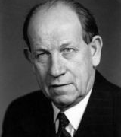
Czech Communist Party
New role – from destruction before 1938 to „State Party“ after 1945
Programme in Košice – communist´s material
Open Policy to the Society – property, anti-German Policy, social plans, USSR as the main Partner
Personalities – Gottwald, Slánský, Ďuriš, Nosek, Kopecký, Zápotocký – State trade union chairman

Slide 18
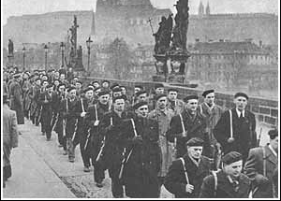
Crisis in National Front 1947/1948
Communist Policy in state Security organisation
Provocations
Media – Czechoslovak Radio, newspapers – Rudé právo (The Red Right)
Demonstrations – people from countryside, trade union, factories, special troops – „People´s Militia“
Crisis in February 1948

Slide 19
Czechoslovakia 1945 – 1948
Nondemocratic system – limited number of political parties, National Front
Role of the USSR
Economical reforms
End of multinational state
Role of the Communist Party
From February 1948 – Communist Dictatorship – to 1989

