Slide 1
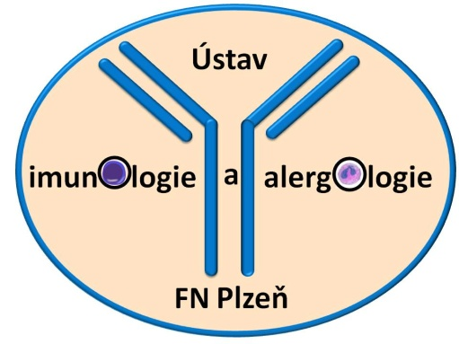
Selected chapters of immunopathological conditions - part 2
Martin Liška
Department of Immunology and Allergology
University Hospital Pilsen
Charles University Prague

Slide 2
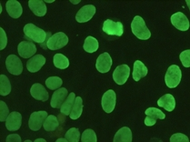
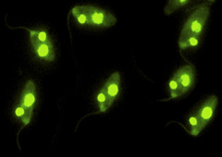
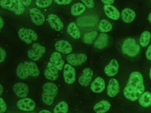
AUTOantibodies against the structures of cell nucleus
Autoantibodies: ANA (Anti-Nuclear Antibodies), a-dsDNA (anti-double-stranded DNA), ENA (Extractable Nuclear Antigens)

Slide 3
Anti Nuclear Antibodies (ANA)
Assessed by using IIF and fluorescence microscope
Most commonly on HEp-2 cells
The test can show both autoantibodies against nuclear and cytoplasmic structures

Slide 4
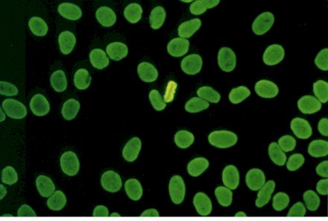
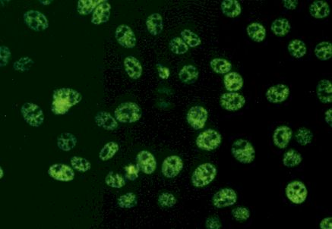
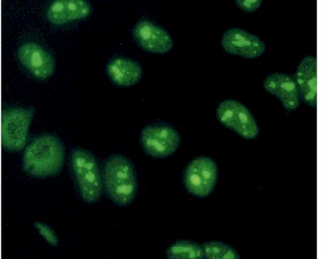
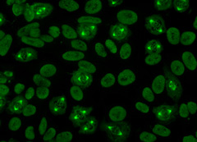
ANA – fluorescence patterns
HEp-2: homogeneous nuclear pattern
HEp-2: speckled pattern
HEp-2: cycle dependent pattern (spindle pole pattern)
HEp-2: homogeneous nucleolar pattern

Slide 5
Autoantibodies against ENA
= autoantibodies against extractable nuclear antigens
De facto a subgroup of nuclear autoantigens
Assessed by using ELISA technique

Slide 6
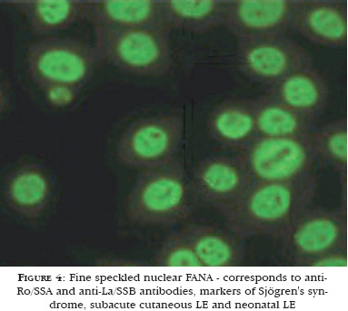
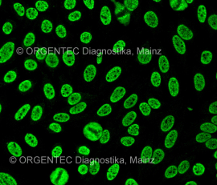
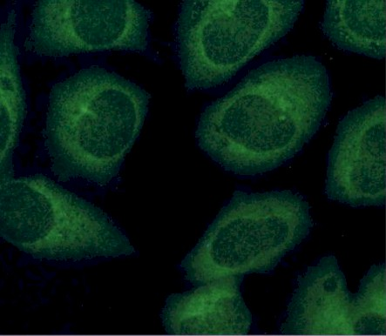
Autoantibodies against ENA
Autoantibodies against ENA: SS-A, SS-B (SLE, SS), a-Sm (SLE), a-RNP (MCTD),
a-Scl-70 (Scl), a-Jo-1 (PM/DM) etc.
SS-A, SS-B: fine speckled nuclear pattern
a-RNP, a-Sm: speckled nuclear pattern
a-Jo-1:
fine speckled cytoplasmic pattern

Slide 7
Anti-dsDNA
Assessed on protist Crithidium luciliae – kinetoplast (mitochondria) contanining dsDNA, but no ssDNA, histones or other antigens
antigen: dsDNA
Clinical association:
especially SLE (specificity 95%)
positive
negative
A.R Bradwell, R.G. Hughes: Atlas of tissue autoantibodies. Atlas of Hep-2 patterns

Slide 8
Rheumatoid factor (RF)
= autoantibodies against Fc fragment of IgG
Positivity typical for RA, but frequently detected in the other systemic autoimmune diseases (SLE, SS)
Assessed by using latex agglutination (IgM) or ELISA (all isotypes)

Slide 9
Autoantibodies typical for vasculitis
ANCA (= Anti-Neutrophil Cytoplasm Antibodies)
Antibodies against various antigens in cytoplasm of neutrophils (enzymes in granuli)
ANCA can activate neutrophils that subsequently take part in pathogenesis of vasculitis (inflammation)
Assessed by using IIF, eventually by using ELISA

Slide 10
Autoantibodies typical for vasculitis (ANCA-associated vasculitides)
p- ANCA (myeloperoxidase) positive (microscopic polyangiitis, Churg- Strauss syndrome
c- ANCA (proteinase 3) positive (Wegener´s
granulomatosis (granulomatosis witgh polyangiitis),
Churg- Strauss syndrome)

Slide 11
Antiphospholipid syndrome (APS)
Autoimmune disease characterized by recurrent venous or arterial thrombosis and detection of antiphospholipid antibodies
Antiphospholipid autoantibodies (APA) → binding to cell surface phospholipids → inhibition of prostacyclin production, increased production of thromboxane, von Willebrand´s factor and tissue factor, activation of platelets → aggregation and destruction of platalets → thrombocytopenia
Symptoms: arterial thrombosis (occlusion of intracranial arteries → stroke; retinal, myocardial, suprarenal or peripheral arteries), recurrent miscarriage, intrauterine growth restriction, preterm birth

Slide 12
Laboratory findings in APS
APS – primary (isolated) or secondary (together with systemic autoimmune disease – e.g. SLE, RA)
Prolonged aPTT, lupus anticoagulant, thrombocytopenia
Antiphospholipid antibodies (APA) - IgG or IgM isotype, most commonly anti-cardiolipin (ACLA), event.anti-ß2glycoprotein I, anti-prothrombin, anti-phosphatidylserine etc.

Slide 13
Autoantibodies and their clinical significance
Organ non-specific autoantibodies | Clinical significance
ANA | Systemic lupus erythematosus
dsDNA | Systemic lupus erythematosus
ENA- SS-A,SS-B | Sjögren´s syndrome, Systemic lupus erythematosus
ENA-Scl-70 | Scleroderma-systemic sclerosis
ENA-Sm | Systemic lupus erythematosus
ENA-Jo-1, PL-7, PL-12 | Dermatomyositis/polymyositis
ACA | CREST syndrome, Scleroderma-systemic sclerosis
ANCA | ANCA-associated vasculitides

Slide 14
Autoantibodies and their clinical significance
Organ non-specific autoantibodies | Clinical significance
APA | Antiphospholipid syndrome
AMA | Primary biliary cirrhosis, drug-induced SLE, chronic active hepatitis and cirrhosis, dermatomyositis/polymyositis
SMA | Chronic active autoimmune hepatitis, viral hepatitis
LKM | Chronic autoimmune hepatitis, viral hepatitis C
StMAB | Myasthenia gravis, polymyositis
RF | Rheumatoid arthritis, Sjögren´s syndrome, Systemic lupus erythematosus

Slide 15
Abbreviations
ANA – Anti-Nuclear Antibodies
ENA – autoantibodies against Extractable Nuclear Antigens
ANCA – autoantibodies Anti-Neutrophil Cytoplasm Antigens
dsDNA – autoantibodies anti-double-stranded DNA
APA – Anti-Phospholipid Antibodies
RF – Rheumatoid Factor
ACA – Anti-Centromere Antibodies
AMA – Anti-Mitochondrial Antibodies
SMA – anti Smooth Muscles Antibodies
LKM – antibodies against Liver-Kidney Microsomes
stMAb – antibodies against striated muscles

Slide 16
Systemic Lupus Erythematosus (SLE)

Slide 17
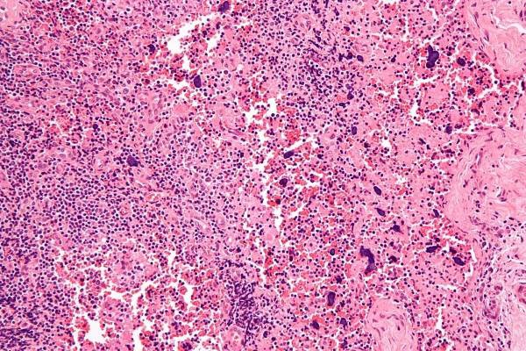
SYSTEMIC LUPUS ERYTHEMATOSUS – basic information
Chronic, inflammatory, multiorgan autoimmune disease
Predominantly affects women (9:1)
Worldwide incidence 1.9 to 8.7/100 000, prevalence 19.3 to 207/100 000
Autoantibodies against the structures associated with cell nucleus, production of immune complexes → deposition in tissues
Serious condition with the difficult treatment

Slide 18
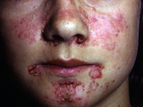
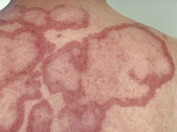
SYSTEMIC LUPUS ERYTHEMATOSUS – clinical manifestations
Nonspecific symptoms: malaise, fever, weight loss
Musculoskeletal involvement
Arthritis and arthralgia – usually symetric, affects ≈ 50% patients with SLE
Tendinitis, myositis/myalgia
Mucocutaneous manifestations
Malar rash – typically across the cheeks and nose („butterfly-like
rash“) , many times on sun-exposed areas
Discoid lesions – usually localized on head and neck
Alopecia, onycholysis
Mouth and nose ulcers

Slide 19
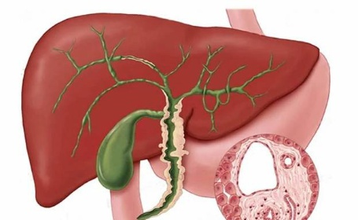
SYSTEMIC LUPUS ERYTHEMATOSUS – clinical manifestations
Gastrointestinal manifestations
Abdominal pain - as high as 40%, due to vasculitis → ischemia
Peritonitis (polyserositis) – frequent, asymptomatic or together with intestinal vasculitis
Pancreatitis – rare
Hepatitis

Slide 20
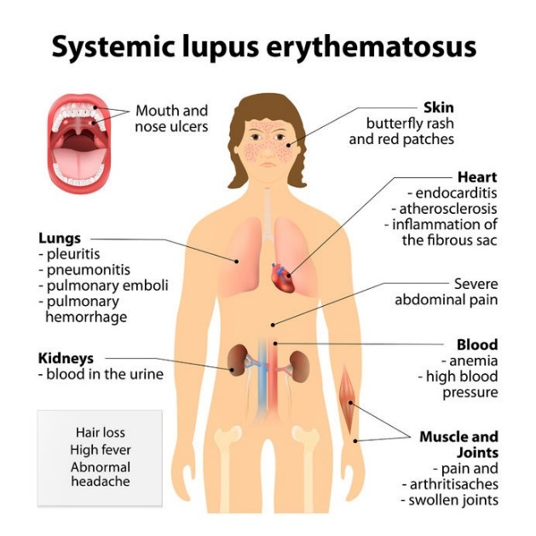
SYSTEMIC LUPUS ERYTHEMATOSUS – clinical manifestations
Pulmonary involvement
Pleuritis – most common pulmonary manifestation (40-56% patients), pleuritic pain, polyserositis
Pneumonitis – dyspnea, cough
Pulmonary hemorrhage – potentially fatal, breath difficultness, hemoptysis
Chronic interstitial lung disease – chronic non-productive cough
Pulmonary hypertension

Slide 21
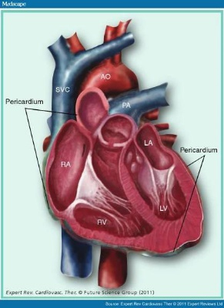
SYSTEMIC LUPUS ERYTHEMATOSUS – clinical manifestations
Cardiac involvement
Cardiomyopathy – resulting from immune-mediated myocardial inflammation and secondary factors (hypertension, medication, coronary artery disease)
Pericarditis – frequent manifestation,
detected by echocardiography
Coronary artery disease – myocardial
infarction, angina, sudden death

Slide 22
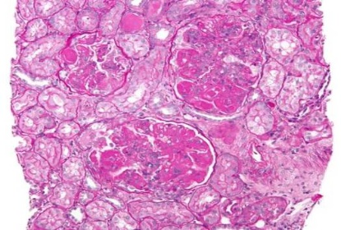
SYSTEMIC LUPUS ERYTHEMATOSUS – clinical manifestations
Renal involvement
Lupus nephritis
Common manifestation (50-75% SLE patients), significant impact on morbidity and mortality
Asymptomatic → nephrotic syndrome or renal failure, hypertension
Examination of urine essential (proteinuria, hematuria in the absence of other ethiologies)
Immunosuppressant treatment (cyclophosphamide, mycophenolate mofetil)

Slide 23
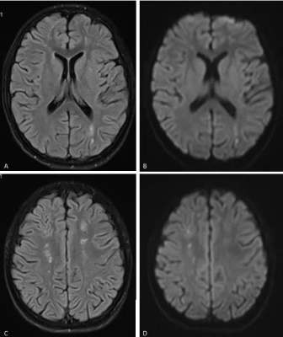
SYSTEMIC LUPUS ERYTHEMATOSUS – clinical manifestations
Hematologic involvement
Anemia – hemolytic anemia, positive Coombs test
Leukopenia – neutropenia or lymphopenia
Thrombocytopenia
Central and peripheral nervous system
Neuropsychiatric symptoms – psychosis, acute confusional state
Headache, seizures
Mononeuropathy, polyneuropathy

Slide 24
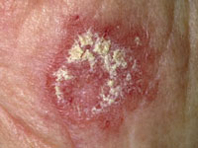
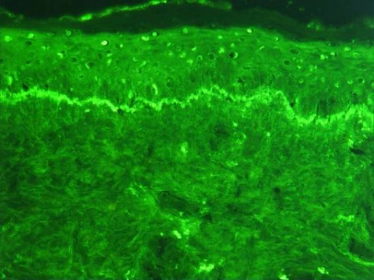
SYSTEMIC LUPUS ERYTHEMATOSUS – laboratory findings
Elevated markers of inflammation: high ESR (erythrocyte sedimentation rate), moderately increased CRP, thrombocytopenia, leukopenia, hemolytic anemia, decreased complement components (C4, C3), elevated serum Ig, elevated immune complexes in serum

Slide 25
SYSTEMIC LUPUS ERYTHEMATOSUS – autoantibodies
Autoantibodies: ANA+, dsDNA+, ENA+ (SS-A/Ro, SS-B/La), Sm, antibodies against histones, APA+

Slide 26
SYSTEMIC LUPUS ERYTHEMATOSUS - treatment
Suppression of inflammation → induction and maintenance of remission
NSAIDs, antimalarials
Corticosteroids, azathioprine, mycophenolate mofetil, cyclophosphamide
Biological treatment – studies on usage of rituximab (anti-CD20) or abatacept (anti-CTLA4)

Slide 27
Rheumatoid Arthritis (RA)

Slide 28
Rheumatoid arthritis – basic information
Chronic, inflammatory, inflammatory joint disease with
systemic involvement
Predominantly affects women (2:1)
Incidence in western countries 0.1 to 0.4/1 000
Persistent activation of cells, deposition of immune complexes in joints and other organs
Initiation of non-specific inflammation → risk factors (genetic, environmental, positive feedback) → production of autoantibodies (RF, ACCP) → amplification in synovium → chronic systemic inflammation

Slide 29
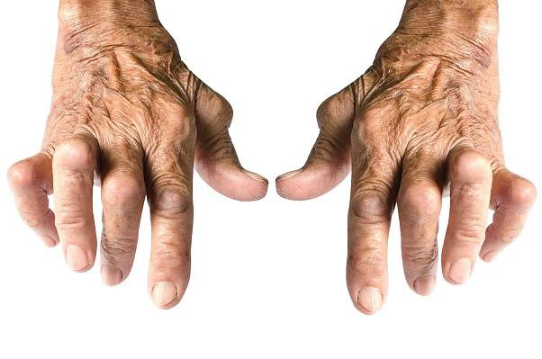
Rheumatoid arthritis – clinical manifestations
Arthritis
Mostly symetrical, typically affects small joints of hands and feet, wrists X sometimes monoarticular
Joint pain, swelling and stiffness
Joint, bone and cartillage destruction

Slide 30
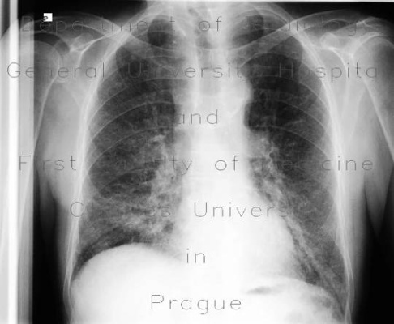
Rheumatoid arthritis – clinical manifestations
General symptoms: fever, sweats, lymphadenopathy, weight loss, fatigue
Dermatological – palmar erythema, subcutaneous nodules, vasculitis, ulcerations
Ophthalmological – episcleritis, keratoconjunctivitis sicca
Pulmonary – pleuritis, interstitial pneumonitis, pulmonary hypertension
Cardiac – pericarditis, myocarditis, coronary vasculitis
Neurological – myelopathy, peripheral neuropathy

Slide 31
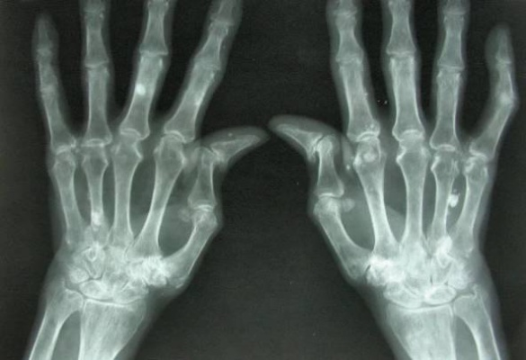
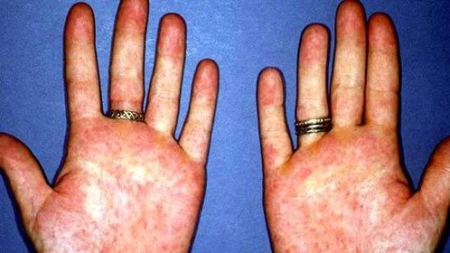
Rheumatoid arthritis – clinical manifestations
Haematological – anemia, thrombocytosis, lymphoproliferative disease
Renal - interstitial nephritis, amyloidosis
Gastrointestinal – sicca syndrome
Musculoskeletal - myositis, muscle weakness, osteoporosis

Slide 32
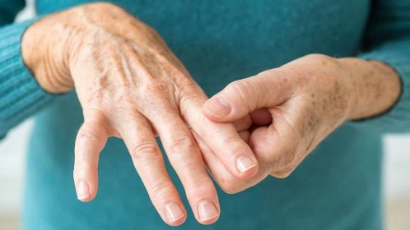
Rheumatoid arthritis – laboratory findings
Elevated markers of inflammation: ESR (erythrocyte sedimentation rate), CRP, elevated serum Ig

Slide 33
Rheumatoid arthritis – autoantibodies
Autoantibodies: RF+ (some cases seronegative), ACCP+ (anti-cyclic
citrullinated peptide antibodies), ANA+, APA+

Slide 34
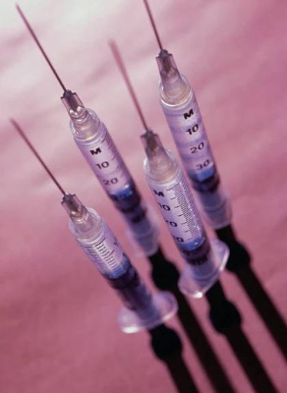
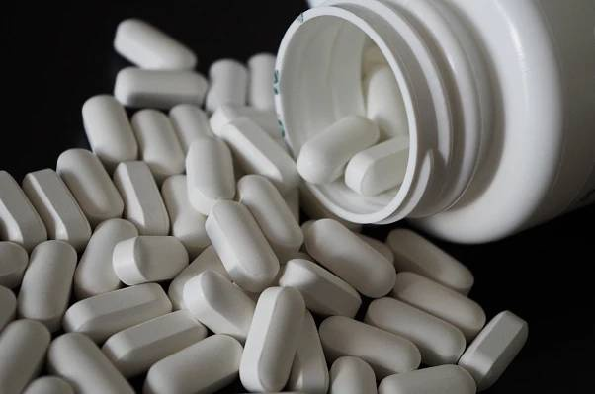
Rheumatoid arthritis - treatment
Suppression of inflammation → induction and maintenance of remission
NSAIDs, antimalarials
Corticosteroids, methotrexate
Biological treatment – infliximab (anti-TNF-α), rituximab (anti-CD20)

Slide 35
Juvenile idiopathic arthritis (JIA)
= A group of chronic inflammatory joint diseases lasting at least 6
weeks a commencing prior to the age of 16 with no identifiable cause
Oligoarticular JIA – 1-4 joints inflammed
Polyarticular JIA – 5 or more joints inflammed
Psoriatic arthritis – arthritis with concurrent psoriasis
Systemic JIA – Still´s disease, younger children, fever + one of the following: macular rash, arthritis, lymphadenopathy hepatosplenomegaly

Slide 36
Sjögren´s Syndrome (SS)

Slide 37
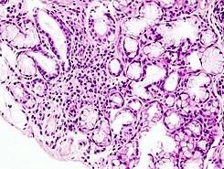
Sjögren´s syndrome – basic information
Chronic systemic autoimmune disease characterized by lachrymal and salivary gland dysfunction
Predominantly affects women (9:1)
Prevalence 0.1 to 4.8% (more strict definition ≈1%)
The pathogenesis of SS is largely unknown → theory: environmental factor (viral infection) in genetically predisposed individual → epithelial cell activation → protracted inflammatory response → autoinflammation

Slide 38
Sjögren´s syndrome – clinical manifestations
General symptoms: fatigue, arthralgia, malaise
Ocular – dry, sandy and sticky eye (sicca sy.), corneal ulcers
Oral – decreased salivary production xerostomia, oral pain, diminished taste, increased tooth decay, swallen major salivary glands (gl.parotis)
Musculoskeletal – in majority of patients with SS (50-75%), arthralgia, synovitis, erosions
Neuropsychiatric – mostly involved peripheral nervous system (sensory neuropathy), autonomic dysfunction (orthostatic hypotension, temperature intolerance, constipation, urinary frequency)
Dermatological – about 50% of patients with SS, dry skin, angular cheilitis, vasculitis, Raynaud phenomenon, alopecia

Slide 39
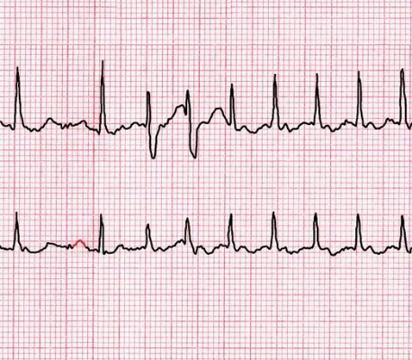
Sjögren´s syndrome – clinical manifestations
Gastrointestinal – dysphagia, nauzea, epigastric pain, constipation, pancreatic dysfunction
Pulmonary – tracheobronchitis sicca (cough), recurrent respiratory infections, interstitial lung disease
Cardiac – uncommon, pericarditis, rhythm abnormalities
Renal – tubulointerstitial nephritis, interstitial cystitis, vaginal dryness
Malignancy – increased risk of lymphoma in SS

Slide 40
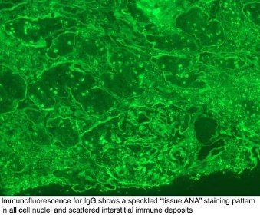
Sjögren´s syndrome – laboratory findings
Increased inflammatory markers: Ig
Autoantibodies: ENA+ (SS-A, SS-B), RF+, ANA+
Schirmer´s test – measures the production of tears

Slide 41
Sjögren´s syndrome - treatment
Symptomatic treatment of sicca syndrome: artificial tears, mucolytic agents, artificial saliva, cholinergic agonists
Cyclosporine in eye drops
Hydroxychloroquine
For extraglandular manifestations immunosuppresants: azathioprine, cyclosporine, methotrexate, mycophenolate mofetil

Slide 42
Vasculitis

Slide 43
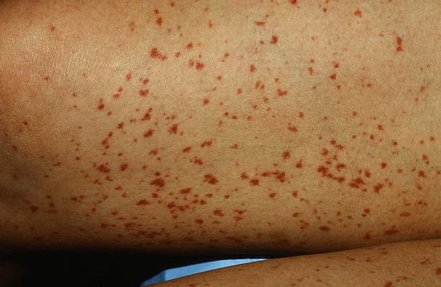
Vasculitis – basic information
Inflammation within blood vessel walls → tendency to stenosis, thrombosis or rupture → ischemic damage of supplied tissue
Vasculitis affects mostly lungs, kidneys or skin
Symptomatology depends on localization of vasculitis and the affected organ

Slide 44
Vasculitis – general symptoms & diagnostics
General symptoms: fever, fatigue, weakness, arthralgias
Organ localized symptoms: abdominal pain, hypertension, renal insufficiency, neurologic dysfunction etc.
Laboratory findings: elevated inflammatory markers (ESR, CRP, leukocytosis)
Autoantibodies: ANCA (AAV), frequently negative
Angiography
Biopsy of affected organ: necrosis, granulomas

Slide 45
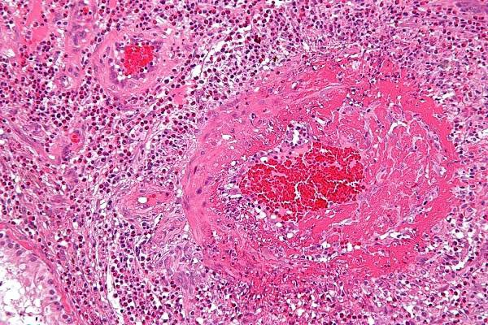
Classification of vasculitides
Large vessel vasculitis (Takayasu´s arteritis, Giant cell (temporal) arteritis)
Medium vessel vasculitis (Polyarteritis nodosa, Wegener's granulomatosis, Kawasaki´s disease)
Small vessel vasculitis (Churg-Strauss arteritis, Microscopic polyangiitis, Henoch-Schönlein purpura, Behçet´s disease)

Slide 46
Granulomatosis with polyangiitis (Wegener´s granulomatosis)
One of the most common forms of systemic necrotizing vasculitis (incidence of 8.5 cases/1 000 000)
ANCA-associated vasculitis (c ANCA)
Necrotizing granulomas in the upper and/or lower respiratory tract
Necrotizing vasculitis affecting arteries and veins
Segmental glomerulonephritis associated with necrosis and thrombosis of capillary loops
Mostly (90%) nasal involvement (crusting, bleeding, obstruction, septal perforation)
Destruction of sinuses, subglottic stenosis (stridor), saddle-nose

Slide 47
Granulomatosis with polyangiitis (Wegener´s granulomatosis)
Lung manifestation – vascular necrosis, pulmonary infiltrates, alveolar hemorrhage
Conductive and sensorineural hearing loss
Renal involvement – segmental necrotizing glomerulonephritis
Other involvements: arthritis, arthralgias, cutaneous granulomata, cranial neuropathies
Treatment: cyclophosphamide + high-dose glucocorticoids
Tendency to recur

Slide 48
Microscopic polyangiitis
One of the most common forms of systemic necrotizing vasculitis (incidence of 8.5 cases/1 000 000)
ANCA-associated vasculitis (p ANCA)
Affected small (and medium) vessels
Fever, weight loss
Rapidly progressive glomerulonephritis
Pulmonary involvement – alveolar hemorrhage
Mononeuritis simplex
Treatment: cyclophosphamide + high-dose glucocorticoids

Slide 49
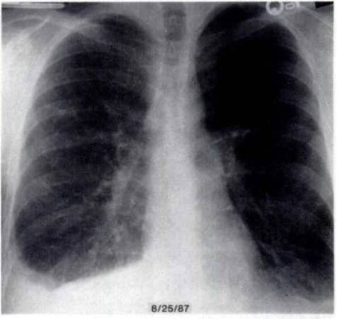
Eosinophilic granulomatosis with polyangiitis (Churg-Strauss syndrome)
ANCA-associated vasculitis (p ANCA or c ANCA)
Symptoms:
Asthma, eosinophilia (both extravascular eosinophilia)
Pulmonary infiltrates
Paranasal sinus abnormality
Mononeuropathy or polyneuropathy
Treatment: glucocorticoids, or glucocorticoids + cyclophosphamide

Slide 50
Vasculitis – treatment
No treatment (Henoch Schönlein purpura)
Immunosuppressive treatment – glucocorticoids, cyclophosphamide, event.azathioprine
IVIG

