Slide 1
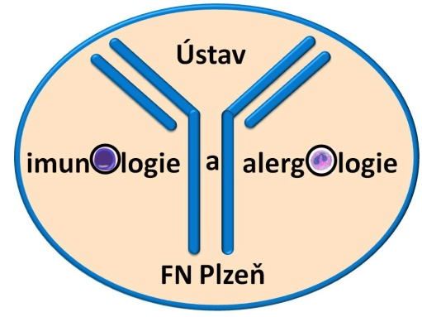
Selected chapters of immunopathological conditions – part 1
Martin Liška
Department of Immunology and Allergology
University Hospital Pilsen
Charles University Prague

Slide 2
Common Variable ImmunoDeficiency (CVID)

Slide 3
Common Variable Immunodeficiency (CVID)
Heterogenous group of PIDs with the latest onset (3rd to 4th decade of life, not earlier than 2 years of age)
Primary antibody immunodeficiency
Prevalence 1:25 000 in caucasians
~20% of PIDs in Czech Republic (2nd most frequent PID)
CVID seems to be the result from a variety of mutations that all contribute to a failure in antibody production (ICOS, TACI, CD19, CD20, CD21, CD81, BAFF-R, NFKB2)
B cells polyclonal, able to recognize an antigen and proliferate X impaired ability to become memory cells and mature plasma cells

Slide 4
Differentiation of B cells
Bone marrow Peripheral lymphoid organs Ig production
MZ B cells
Plasma cell
Pro B cell
Pre B I
Pre B II
Transitional B cell
Stem cell
Immature B cell
Naive B cell
Germinal center Memmory B cell

Slide 5
Common Variable Immunodeficiency (CVID)
Laboratory findings:
↓IgG+A more than 2 SD (↓IgM) – IgG < 5 g/l
Number of B cells usually normal or slightly decreased, but pathological phenotyping (↑ naïve B cells, ↓ class-switched memory B cells, ↑ CD21_{low} (↑ risk of autoimmunity))
Decreased response to vaccination: protein antigens (TAT), polysaccharide antigens (PCP, Typhoid fever)

Slide 6
Common Variable Immunodeficiency (CVID)
Clinical symptoms:
Recurrent respiratory tract infections (pneumonia, sinusitis, bronchitis, otitis) caused by encapsulated bacteria (Streptococcus pneumoniae, Haemophilus influenzae), Staphylococcus aureus, Pseudomonas aeruginosa, Mycoplasma pneumoniae
Antibody deficiency without proofed cause (malignancy, biological therapy )
Chronic diarrhea – Giardia intestinalis (→ malabsorption syndrome resembling celiac sprue)

Slide 7
Common Variable Immunodeficiency (CVID)
Complications:
Bronchiectasis
Autoimmunity: pernicious anemia, autoimmune hemolytic anemia, idiopathic thrombocytopenic purpura, psoriasis, vitiligo, rheumatoid arthritis, primary hypothyroidism, atrophic gastritis, celiac disease, SLE, Sjögren´s syndrome
Malignancies: non-Hodgkin´s lymphomas
Lymphoproliferation, granulomas (lung, lymph nodes, skin, bone marrow, liver)

Slide 8
Common Variable Immunodeficiency (CVID)
Treatment:
Life-long Ig replacement – IVIG (400 mg/kg b.w./month) or SCIG (100 mg/kg b.w. every 5 or 6 days)
Long-term follow-up (pulmonary fibrosis, lymphoproliferation, haematological disorders) – blood cell count, biochemistry, spirometry, chest X-ray, abdomen ultrasonography, HRCT
Regular examination of serum IgG level, assessment of complications

Slide 9
Severe Combined ImmunoDeficiency (SCID)

Slide 10
Severe Combined Immunodeficiency (SCID)
One of the most severe PIDs
1.5% of PIDs in Czech Republic
Combined deficiency of cellular and humoral immune response
Without early HSCT, patients die soon
Defect of T cell function which is accompanied with B cell and NK cell disorder

Slide 11
Severe Combined Immunodeficiency (SCID)
T-B+NK- form
The most common is X-linked form
The mutation affects so called common gamma chain (protein shared by receptors of various cytokines (IL-2, IL-4, IL-7, IL-9,IL-15, IL-21)) → severe defect of lymphocyte development and differentiation → severe decrease or absence of T cells and NK cells
Number of B cells normal X insufficient help from T cells → insufficient production of antibodies

Slide 12
Severe Combined Immunodeficiency (SCID)
JAK-3 deficiency
Similar features like X-linked form (defect of signal transmission through common gamma chain)
Purine nucleoside phosphorylase (PNP) deficiency
AR inheritance
The defect leads to purine metabolites accumulation → toxic effect to lymphocytes (PNP) → absence of T cells, B cells +/-

Slide 13
Severe Combined Immunodeficiency (SCID)
T-B-NK- form
Adenosine deaminase (ADA) deficiency
AR inheritance
These defects lead to purine metabolites accumulation → inhibition lymphocyte proliferation → absence of T and B cells
Multiorgan affection (CNS, liver, kidney, lungs, skeleton, bone marrow)
Reticular dysgenesis syndrome
AR inheritance
The most severe form of SCID
Mutation of adenylate kinase 2 gene (AK2) → increased apoptosis of myeloid and lymphoid precursors
Severe lymphopenia, neutropenia, deafness

Slide 14
Severe Combined Immunodeficiency (SCID)
T-/+B-NK+ form
Omenn syndrome
Severe PID belonging to SCID group
Mutation of RAG recombinases (RAG1, RAG2) →impaired VDJ recombinations of TCR gene segments → proliferation of one or several clones of autoreactive T cells → unlike in classical SCID, Omenn syndrome need not to display T lymphopenia (numbers of T cells can be increased) X number of B cells and Ig are very low
Symptoms: lymphadenopathy, hepatomegaly, generalized erythroderma with alopecia, symptoms
typical for SCID (pneumonia, chronic diarrhea, failure to thrive)
Dg: evidence of T cells clonality
genetic testing
Artemis deficiency
AR inheritance
Defective VDJ recombinations of TCR, radiation sensitivity

Slide 15
Severe Combined Immunodeficiency (SCID)
T-B+NK+ form
IL-7Rα deficiency
AR inheritance
Abnormal IL-7R signalling
Absence of thymus
CD45 deficiency
AR inheritance

Slide 16
Combined T cell and B cell deficiencies

Slide 17
Severe Combined Immunodeficiency (SCID)
Clinical symptoms of SCID:
Onset in infancy
Commonly severe infections of respiratory tract (pneumonia)
Failure to thrive, exanthemas similar to eczema, chronic diarrhea
Absence of tonsils and adenoids
Infections caused by bacterias (Mycobacteria), viruses (CMV, Parainfluenza, Rotavirus, EBV) or opportunistic pathogens (Pneumocystis jirovecii, Candida, Aspergillus), infections caused by BCG (BCGitis)
Laboratory findings – dependent on type of SCID, usually lymphopenia
TREC, KREC

Slide 18
Algorithm to evaluate a suspected cellular immune defect
Screening evaluation | CBC with differential
 | Immunophenotyping (T-, B-, NK-cell counts and CD45RA/RO+ status)
Advanced testing | Functional testing: DTH testing Mitogen stimulation Cytotoxicity assay
 | TREC, KREC assay
 | Genetic evaluation
 | Advanced flow studies (Th₁₇, CD40L, WASp, etc.)

Slide 19
TRECs (T cell Recombination Excision Circles)
Detection of excised DNA fragments generated during normal splicing of TCR and maturation of T cell
Maturation process is absent across all SCID variants, as evidenced by the low counts of T cells
TRECs are performed using dried blood from a Guthrie card from which DNA is extracted
Newborn screening in some states of the U.S.A.

Slide 20
Severe Combined Immunodeficiency (SCID)
Treatment of SCID:
The only successful and ultimate treatment is HSCT performed as soon as possible
Patients with ADA deficiency can also benefit from enzyme replacement therapy or gene therapy
Substitution of Ig
Patients should not receive any live vaccines (BCG, MMR, Rotavirus)

Slide 21
Secondary Antibody Deficiencies

Slide 22
Hematological malignancies
B cell lineage lymphoproliferative diseases (chronic lymphocytic leukaemia, CLL)
Frequently significant hypogammaglobulinemia, IgG subclass deficiency , poor specific antibody responses (esp.to pneumococcal polysaccharides)
Pathogenesis of hypogammaglobulinemia:
- replacement of normal B cells by (non-functional) CLL B cells → ↓B
cell function
- CLL B cells → subverting of T cell help → ↓B cell function
- CLL B cells → interaction with bone marrow plasma cells via Fas-
ligand/Fas interactions → ↓ production of Ig
- treatment related (chemotherapy, biological treatment)

Slide 23
Hematological malignancies
Most frequently: chronic lymphocytic leukaemia (CLL) and multiple myeloma
Less frequently: Hodgkin’s and non-Hodgkin’s lymphomas, diffuse large B cell lymphoma, follicular lymphoma, mantle cell lymphoma, marginal zone lymphoma, Burkitt’s lymphoma
Beside humoral deficiency, cellular and innate immunosupression (CLL) → susceptibility to viral, fungal and opportunistic infections
Infections are an important cause of morbidity
Treatment: clinically significant humoral defect (↓Ig, recurrent and/or severe bacterial infections, poor specific antibody responses) → ATB prophylaxis → in case of failure replacement immunoglobulin

Slide 24
Protein-losing states
a/ Protein-losing enteropathies
Primary:
- inflammatory (Crohn’s disease, ulcerative colitis, coeliac disease)
infectious (enteric infections)
Protein loss via mucosal injury → hypoalbuminemia, ↓IgG
Treatment: therapy of underlying disorder
replacement immunoglobulin only exceptionally
Secondary:
- intestinal lymphangiectasia)

Slide 25
Protein-losing states
Intestinal lymphangiectasia
primary lymphangiectasia is rare congenital disease
dilatations in mucosal and submucosal lymphatics → leakage of lymph into bowel lumen → ↓albumin, ↓Ig, ↓ lymphocytes
primary can be associated with the other syndromes (yellow-nail sy., neurofibromatosis type 1, Turner’s sy., Noonan’s sy. etc.
secondary in IBD, right-sided heart failure (↑central venous pressure)
patients can suffer from bacterial and opportunistic infections
Treatment: dietary exclusion of long chain fatty acids (limits losses into GIT)
surgical treatment
ATB prophylaxis and/or Ig replacement could be considered in
symptomatic patients

Slide 26
Protein-losing states
b/ Protein-losing nephropathies
Nephrotic syndrome
Loss of albumin through glomeruli → edema, anasarca, loss of IgG →
hypogammaglobulinemia
Treatment: therapy of underlying disorder

Slide 27
Disorders associated with impaired lymphatic circulation
a/ chylothorax
= presence of chyle in pleural cavity
Causes: damage to thoracic duct (trauma, surgery)
malignant obstruction of thoracic duct
mediastinal lymphadenopathy
thrombosis of superior vena cava
Chylothorax → loss of Ig and T cells → risk of bacterial and opportunistic
infections
Treatment: therapy of underlying condition
b/ Proteus syndrome
= congenital disorder that causes skin overgrowth and atypical bone
development
Sequestration of Ig and lymphocytes in area of lymphoedema + intestinal
lymphangiectasia + hypercatabolism of IgG →↓IgG+A

Slide 28
Disorders associated with increased immunoglobulin catabolism
Myotonic dystrophy
Decreased levels of IgG attributed to hypercatabolism of IgG
Clinical significance of hypogammaglobulinemia is unclear
Treatment: in symptomatic patients, ATB prophylaxis, event.Ig replacement

Slide 29
Iatrogenic antibody deficiency
a/ Rituximab
= monoclonal antibody against CD20 used for treatment of
lymphoproliferative diseases and systemic autoimmune diseases (RA,
Wegener’s granulomatosis, Churg-Strauss sy.)
B cell depletion → ↓Ig
Hypogammaglobulinemia observed esp.in B cell lymphoma (functional
defect ? effect of chemotherapy ? effect of rituximab ? combination ?)
Treatment: minority of patients develop sustained hypoIg requiring
Ig replacement

Slide 30
Iatrogenic antibody deficiency
b/ CD19-targeted chimeric antigen receptor T cells (CART)
Use of CART against B cell antigens (CD19) to treat acute lymphoblastic
leukaemia (ALL) was associated with B cell aplasia →↓Ig
Treatment: sometimes Ig replacement
c/ Atacicept
= humanized recombinant fusion protein against TACI → B cell
suppression
Tested in treatment of lupus nephritis → some subjects developed
hypogammaglobulinemia and serious infections

Slide 31
Iatrogenic antibody deficiency
d/ Imatinib
= a selective tyrosine kinase inhibitor
Tested for treatment of chronic myeloid leukaemia (CML) – some patients
developed hypogammaglobulinemia, maybe due to inhibition of Ig class
switch recombination
e/ Mycophenolate mofetil
Inhibits de-novo synthesis of purines in lymphocytes → wide
ranging effects across the immune system, but preferentially on B cell
activation, proliferation and plasma cell generation
Used for treatment of transplanted patients or patients with SLE
Some patients developed hypogammaglobulinemia with bronchiectasis

Slide 32
Iatrogenic antibody deficiency
f/ Cyclophosphamide
= alkylating agent killing activated T cells and B cells →
immunosuppressive efects
Hypogammaglobulinemia and lymphopenia are well-recognized adverse effects
Used in combination with high-dose steroids and rituximab
g/ Corticosteroids
Some patients develop moderate reduction of IgG by systemic oral
steroid treatment, but without clinical symptoms

Slide 33
Iatrogenic antibody deficiency
h/ Antiepileptics
Some patients treated with phenytoin, carbamazepine, sodium
valproate and lamotrigine developed hypogammaglobulinemia, some
of them required Ig replacement
Pathogenesis is unclear
i/ Other drugs
Sulphasalazine (RA, IBD) and chlorpromazine (psychosis) can cause
secondary hypogammaglobulinemia

Slide 34
Hereditary Angioedema (HAE)

Slide 35
Hereditary Angioedema (HAE)
Disorder of complement system and bradykinin metabolism regulation
≈ 10% of PIDs in Czech Republic
Atypical symptomatology for PID (recurrent swellings)
Possible to treat

Slide 36
Hereditary Angioedema (HAE)
Inherited absence (HAE I) or functional defect of C1 inhibitor (HAE II)
HAE III – estrogen dependent with or without mutation of F XII
C1-inhibitor = regulation of complement system, kinin and hemocoagulation cascade → in case of C1-INH deficiency: dysregulation of bradykinin metabolism → swellings

Slide 37
Kininogen
Surface
Factor XI
Factor XII
Factor XIIa
Kinin cascade
Factor XIa
Kalikrein
Prekallikrein
tPA
UK
Haemocoagulation system
Kallikrein inhibitor
C1
C1r, C1s
Plasminogen
Plasmin
Fibrinolytic system
C2
C4b2a
C4
BRADYKININ
Fibrin degradation products
Complement system
APP neutral andopeptidase
Carboxypeptidase
(Kininase I)
Icatibant
ACE (kininase II)
BRADYKININ (1-8)
concentrated
C1 inhibitor
recombinant
C1 inhibitor
B2R
B1R
BRADYKININ (1-7)
ACE (kininase II)
ANGIOEDEMA
BRADYKININ (1-5) inactive
Induced by inflammation
Caballero T et al,

Slide 38
Hereditary Angioedema (HAE)
Symptoms:
Recurrent swellings of skin, mucous membranes of larynx, gut (mimicking intestinal obstruction)
Onset mostly in adolescence
Triggering factor most frequently injury, surgery (e.g.dental intervention), intercurrent infection
Laryngeal swelling could be life-threatening without rescue therapy

Slide 39
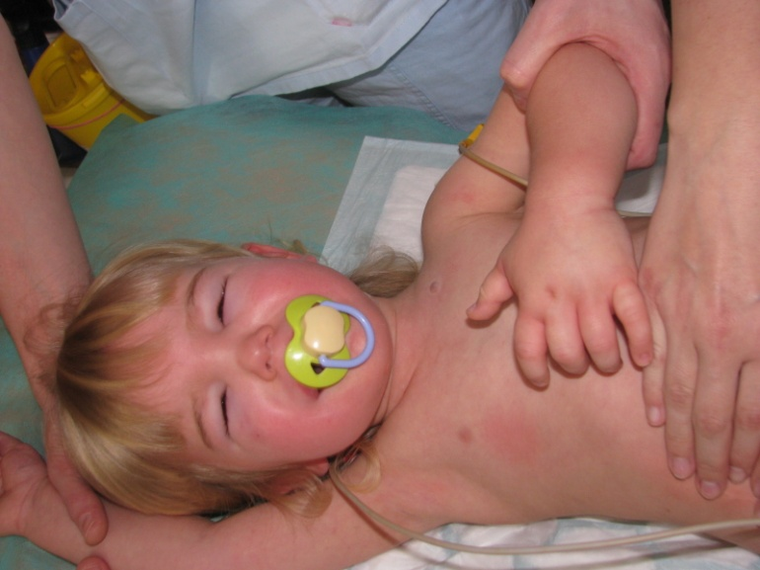
Swellings in HAE

Slide 40
Hereditary Angioedema (HAE)
Diagnosis:
Dg: C1-inhibitor concentration assessment
C4 concentration assessment
functional test of C1-inhibitor
genetics
exclusion of secondary cause (malignancy, ACE-inhibitor
treatment)

Slide 41
Hereditary Angioedema (HAE)
Treatment:
Preventive – androgens (Danazol®), antifibrinolytics
(tranexamic acid – Exacyl®), C1-inhibitor concentrate (Berinert®)
Rescue – administration of C1 inhibitor concentrate i.v.
(Berinert®), selective bradykinin-receptor inhibitor s.c. (icatibant
– Firazyr®), recombinant C1-inhibitor (Ruconest®) i.v.

Slide 42
Therapy of immunological conditions by using biological agents

Slide 43
Monoclonal antibodies
Immunoglobulins produced by a single clone of B cells, or more precisely cells artificially created by hybridisation of B cells of specific antigenic specifity (= produced Ig have the same antigenic specifity) with tumor cell (= cells are „immortal“)

Slide 44
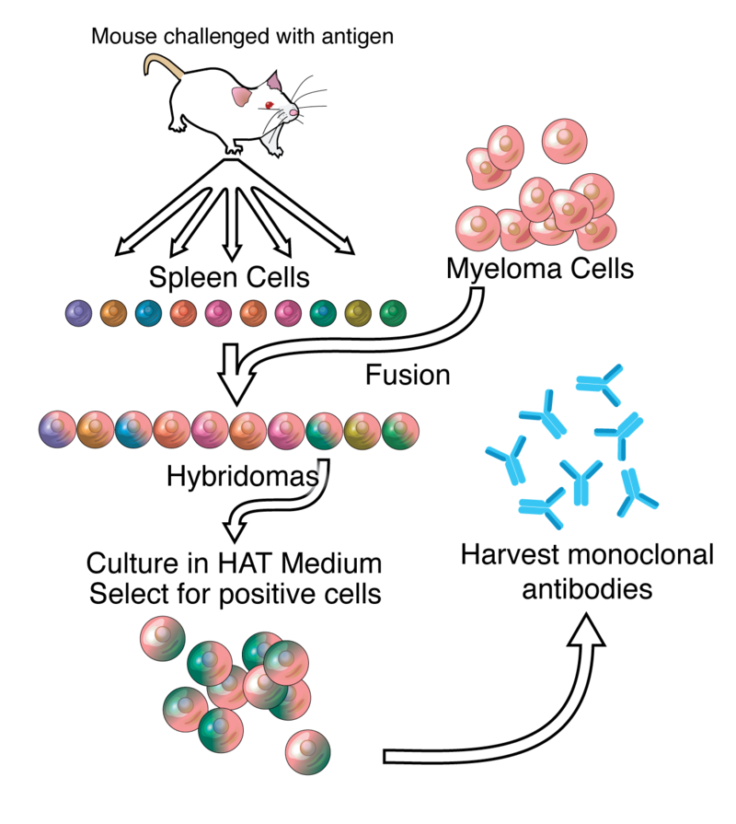
Monoclonal antibodies

Slide 45
The utilization of monoclonal antibodies:
Diagnostics (flow cytometry, ELISA, indirect immunofluorescence etc.)
Biological treatment (autoimmune diseases, malignancies, immunodeficiencies)

Slide 46
Biological response modifiers
Class | FDA indications | EMA indications | Immune side effects | General infectious issues | Specific infectious risk
TNF-α antagonists (infliximab, etanercept, adallimumab, certolizumab, golimumab) | Rheumatoid arthritis Ulcerative colitis (adult and pediatric) Crohn disease (adult and pediatric) Psoriasis (arthritis and plaque) Ankylosing spondylitis Polyarticular juvenile idiopathic arthritis Hidradenitis suppurativa Uveitis | Same as FDA but not including hidradenitis suppurativa and uveitis | Cutaneous psoriasis Cutaneous neoplasms Anti-dsDNA Cutaneous/discoid lupus Demyelinating disease IBD among spondyloarthopathy Cytopenias Anti-phospholipid syndrome Sarcoidosis Dermatomyositis Polymyositis Autoimmune hepatitis | Granuloma breakdown Mycobacteria Fungus Intracellular bacteria Viral Parasitic | Histoplasma species Pneumocystis jirovecii pneumonia Listeria species Legionella species Coccidioides Candida species Aspergillus species TBC HSV HBV Blastomyces species
Adopted from Davis et al., 2017

Slide 47
Biological response modifiers
Class | FDA indications | EMA indications | Immune side effects | General infectious issues | Specific infectious risk
Anti-CD20 (rituximab, ofatumumab) | Non-Hodgkin lymphoma Chronic lymphocytic leukemia Granulomatosis with polyangiitis Rheumatoid arthritis | Same as FDA but not including GPA | Cytokine release Hypogamma globulinemia Cytopenias | Viral Bacterial Fungal Osteomyelitis Otitis Conjunctivitis Enteritis Upper respiratory tract infections Pneumonia/ bronchitis Cellulitis | Progressive multifocal leukoencephalopathy Pseudomonas species CMV HSV VZV Haemophilus influenzae Streptococcus pneumoniae Klebsiella species Aspergillus species Candida species Staphylococcus aureus Campylobacter species West Nile virus HBV and HCV Parvovirus b19
Adopted from Davis et al., 2017

Slide 48
Biological response modifiers
Class | FDA indications | EMA indications | Immune side effects | General infectious issues | Specific infectious risk
CD80/CD86 antagonists (abatacept, belatacept) | Rheumatoid arthritis Kidney transplant rejection in EBV seropositive patients Polyarticular juvenile idiopathic arthritis | Same as FDA | Posttransplantation lymphoproliferative disease in EBV seronegative patients | Sinusitis Nasopharyngitis Bronchitis Urinary tract infection Gastroenteritis Pneumonia Cellulitis Pyelonephritis Diverticulitis Sepsis Bacterial Viral Fungal | Candida species TBC HSV Influenza VZV Aspergillus species Histoplasma species CMV Progressive multifocal leukoencephalopathy Polyomavirus nephropathy
Anti-CD52 (alemtuzumab) | Chronic B-cell lymphocytic leukemia Multiple sclerosis | Multiple sclerosis | ITP Hemolytic anemia Neutropenia Pancytopenia | Systemic viral infections Systemic fungal infections Bacterial Protozoa | TBC reactivation Mucor VZV HSV CMV EBV Pneumocystis jirovecii pneumonia Candida species Aspergillus species Cryptococcus species
Adopted from Davis et al., 2017

Slide 49
Biological response modifiers
Class | FDA indications | EMA indications | Immune side effects | General infectious issues | Specific infectious risk
IL-1 antagonist (anakinra, canakinumab, rilonacept) | Rheumatoid arthritis Periodic fever syndromes Systemic juvenile idiopathic arthritis | Same as FDA | Pneumonitis Colitis Hepatitis Endocrinopathies Nephritis Dermatitis Encephalitis Psoriasis Vitiligo Neutropenia | Common bacterial and viral infections
IL-6R antagonist (tocilizumab) | Rheumatoid arthritis Systemic juvenile idiopathic arthritis Polyarticular juvenile idiopathic arthritis | Same as FDA | Elevation of transaminases Lipidemia | Mycobacterial reactivation Pneumonia Upper respiratory tract infections Cellulitis Gastroenteritis Diverticulitis Sepsis Bacterial arthritis | TBC VZV Cryptococcus species Aspergillus species Candida species Pneumocystis species
α4-integrin antagonist (natalizumab) | Multiple sclerosis Crohn disease | Multiple sclerosis | Hepatotoxicity | Upper respiratory tract infections Gastroenteritis Vaginitis Tonsillitis Tooth abscess | Progressive multifocal leukoencephalopathy CNS VZV CNS HSV
Adopted from Davis et al., 2017

Slide 50
Biological response modifiers
Class | FDA indications | EMA indications | Immune side effects | General infectious issues | Specific infectious risk
Anti-IgE (omalizumab) | Severe persistent asthma Chronic spontaneous urticaria | Same as FDA | ↓ serum IgE
Anti-IL-5 (mepolizumab, reslizumab) | Severe persistent asthma with eosinophilia | Same as FDA | ↓ eosinophil count
IL-4Rα antagonist (dupilumab) | Severe atopic dermatitis | Not approved | ↓ serum IgE
IL-5Rα antagonist (benralizumab) | Severe persistent asthma with eosinophilia | Same as FDA | ↓ eosinophil count

Slide 51
Immunoglobulin replacement therapy
Immunoglobulin concentrates are made from human plasma pooled from thousands of donors
Donors are tested for infectious diseases (HIV, hepatitis), inactivating procedures to minimize the risk of transmitting infection
Ig concentrates contain only IgG, content of IgA is minimal
Preparates for i.v. (Gammagard, Octagam) or s.c. administration (Subcuvia, Gammanorm)

Slide 52
Indications for Ig replacement therapy
Primary antibody deficiencies (IVIG) – life-long in XLA or CVID, transitory in combined immunodeficiencies (SCID)
IgG subclasses or specific Ig deficiency is sometimes also indication
Secondary antibody deficiencies – typically B cell leukemia, lymphomas

Slide 53
Dosage of Ig concentrates
Agammaglobulinemia – i.v. imunoglobulins 400-600 mg/kg/month
Regular administration in day-care centres every 3 or 4 weeks
Last years, „home therapy“ is frequently used - administration of subcutaneous Ig by infusion pump (cca every 5 to 7 days, more comfortable for patient, less adverse effects)

Slide 54
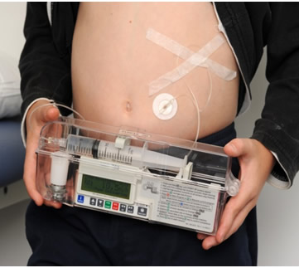
Administration of subcutaneous Ig by infusion pump

Slide 55
Adverse effects of the treatment
Allergic reactions, anaphylaxis
In less severe reactions (shivers, headache), slowing down the infusion is usually sufficient
Sometimes, premedication with intravenous corticosteroids is necessary
Change of preparate (lower content of IgA)

