Slide 1
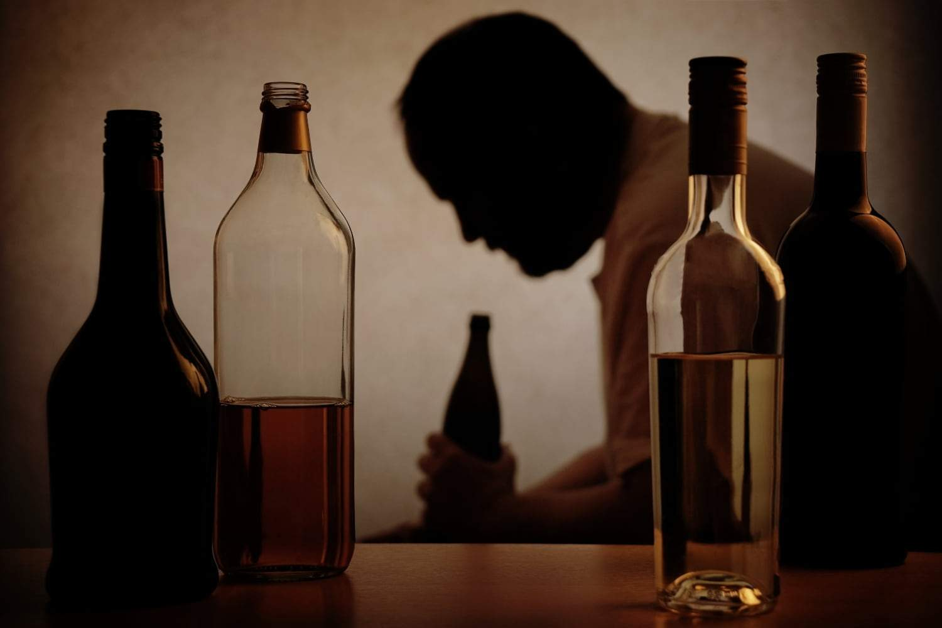
Alchohol addiction
Alcohol addiction
Falck-Muus Henrik Chiarello, Schánělová Natálie, Korbel Jiří, Mariia Nikitina

Slide 2
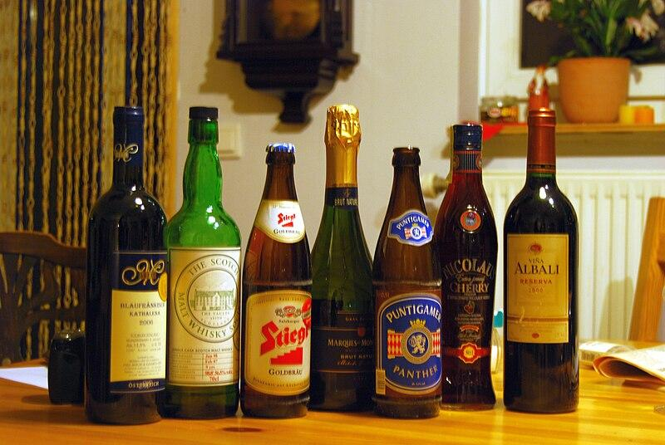
What Alcohol Addiction is
Alcohol addiction, also known as alcohol use disorder (AUD), is a chronic disease characterized by an inability to control or stop drinking despite negative consequences to one's health, relationships, or responsibilities. It involves both a physical and psychological dependence on alcohol.
→ undermines productivity, social stability, community safety → pressing issue for public policy intervention

Slide 3
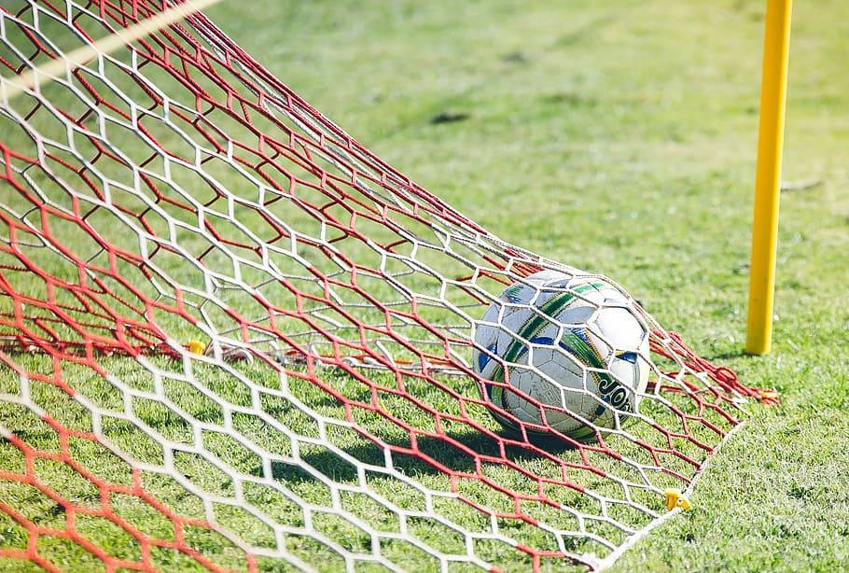
Goals
To reduce alcohol consumption and its consequences in the Czech Republic
differentiation of our solutions between different target groups

Slide 4
Target Groups
When discussing target groups of alcohol addiction, it is essential to consider the diverse demographic, social, and psychological factors that contribute to vulnerability.
Adolescents and young adults
Teenagers and students
Socioeconomically Disadvantaged Groups
Professionals in High-Stress Occupations
Genetic and Family History Groups

Slide 5
Strategy list of behavioural solutions - Nudges
Distribution of literature/flyers on the dangers of alcohol overconsumption
Inscription at the bottom of the glass with for example: Do you really need more?
Advertise for alcohol free alternatives in bars or restaurants
Advertise in public places how much one could save in a year by not buying for example a beer every other day. Make the people see the sum of money they could save.
Color labelling system for alcohol according to alcohol content

Slide 6
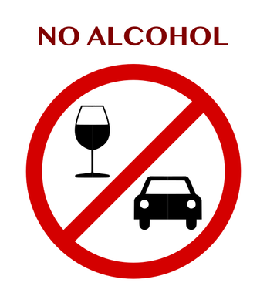
Strategy list of behavioural solutions - Policy bans and restrictions
Creating alcohol free spaces in public places
Reduce the size of units. For example, reduce the size of bottles or glasses at bars.
Remove alcohol from easily visible places in grocery stores. Place alcohol at the back of the grocery store, and not in the most trafficked isles.
Make alcohol less accessible by reducing the hours that alcohol can be sold in grocery stores.
Ban advertisement for alcohol

Slide 7
Strategy is list of behavioural solutions
The most effective ones
Reduce the size of units. For example, reduce the size of bottles or glasses at bars.
Remove alcohol from easily visible places in grocery stores.
Make alcohol less accessible by reducing the hours that alcohol can be sold in grocery stores.
Creating alcohol free spaces in public places
The least effective ones
Distribution of flyers on the dangers of alcohol overconsumption.
Advertise for alcohol free alternatives in bars or restaurants.
Advertise the amount of possible spending from not drinking alcoholic beverages.
Color labelling system for alcohol according to alcohol content.
Inscription at the bottom of the glass with for example: “Do you really need more?”

Slide 8
Effectiveness Evaluation Methods
At the first stage we have to do background research to define the key metrics:
Before implementing the strategy a research and needs analysis among target groups will be done
Metrics from governmental statistics and alcohol industry sells statistics
In the middle of the process a mid-term evaluation based on the metrics needs to be done:
comparing the changes in the data before/now
observing the impact of the nudges on a different target groups and their reaction
→ correction of the strategy based on results of mid-term check up
The final analysis includes the study on changes in behaviour towards alcohol of the groups presented above.

Slide 9
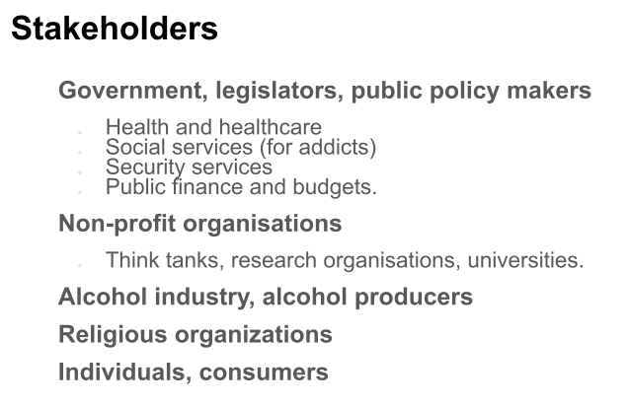
Implementation
Conduct pilot programs in specific areas to test the effectiveness of nudges and policy bans
Collaborate with the stakeholders which are the government, Health organizations and large businesses
Launch public education campaigns to build awareness and support

Slide 10
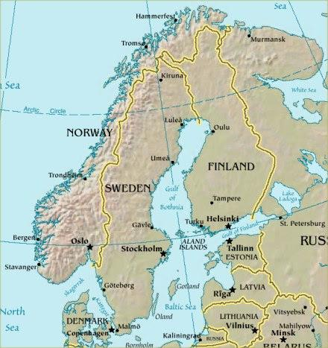
Case studies and examples - Scandinavia
The following policy bans and restrictions have been successfully implemented in scandinavian countries:
Banning alcohol advertising
Reducing the hours of which alcohol can be sold
Reducing the size of a beverage
Will take a lot of political work to implement

Slide 11
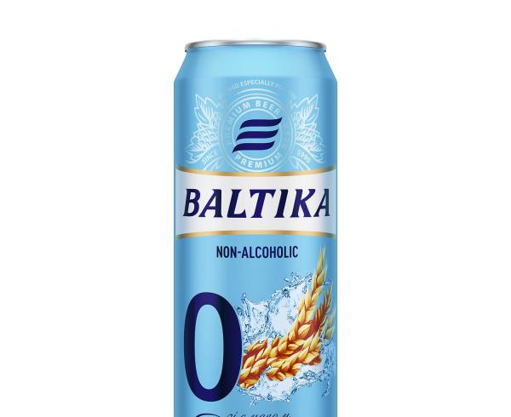
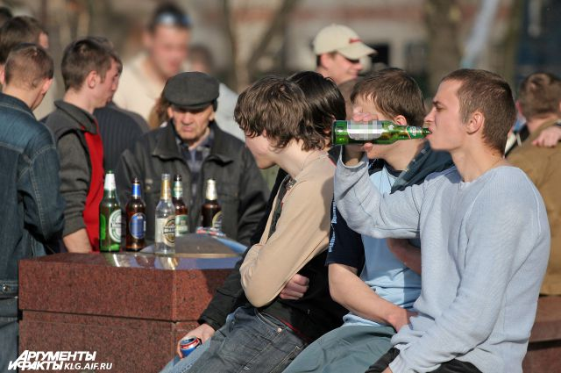
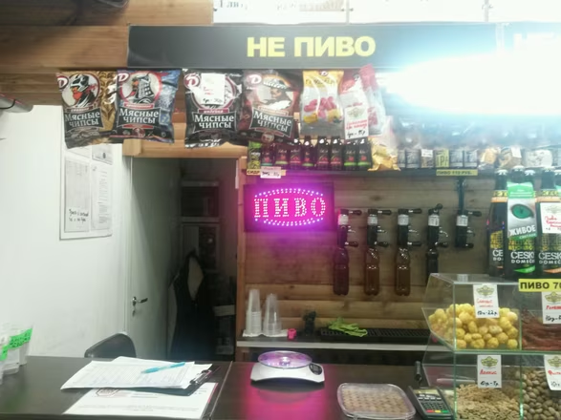
Case studies and examples - Russia
Ban on drinking in public spaces.
Max fine ~ 50€
How to avoid: use coffee cups/thermos
Ban of alcohol advertisement.
How to avoid: promote 0% alcohol beers
Restricted selling hours in the markets
How to avoid: open the cheap bar near the alco-market working during the restricted hours
not beer
beer

