Slide 1
INTRODUCTION TO COURSE
20 February 2024
Pavlína Vágnerová

Slide 2
INTERNATIONAL … what?
Plan for today
Who prepared this course?
What are we going to study?
Who will be teaching the course?
What will be required from you?
Disputes & Dispute resolution methods
UN Convention on Contracts on the International Sale of Goods
INTERNATIONAL COMMERCIAL
DISPUTE
RESOLUTION

Slide 3
COURSE STRUCTURE
Week 1 | 20.02.2024 | Introduction to course. Alternative dispute resolution. Contract on the International Sale of Goods
Week 2 | 27.02.2024 | Negotiation: theory and practise I (Case study)
Week 3 | 05.03.2024 | Negotiation: theory and practise II (Case study)
Week 4 | 12.03.2024 | Logical fallacies and how to spot them
Week 5 | 19.03.2024 | Harvard Negotiation Game
Week 6 | 26.03.2024 (105) | Harvard Negotiation Game
Week 7 | 02.04.2024 | International Commercial Arbitration I (Ondřej Čech)
Week 8 | 09.04.2024 | International Commercial Arbitration II (Ondřej Čech)
Week 9 | 16.04.2024 | Mediation (Veronika Vrábel Porteš)
Week 10 | 23.04.2024 | Investment Arbitration I (Tamara Korešová)
Week 11 | 30.04.2024 | Investment Arbitration II: Moot Court (Maria Poláková)
Week 12 | 07.05.2024 | Role of Economists in Dispute Resolution Practice
Week 13 | 14.05.2024 | Rector‘s Sports Day Off

Slide 4
Who am I and who are you?
Pavlína vágnerová
Studies – VŠE and IES (joint masters with Strasbourg)
During college and University – studied in England, Ireland and France
Senior Associate in PwC Forensics team
Forensic investigations, financial crime and expert witness work
University lecturer since 2018
Leadership of a non-profit association Technická přestávka (adventure camps for young adults)
‚learning by playing‘

Slide 5
Who is going to teach?
Ondřej čech
Ondřej is a Senior associate at Zeiler Floyd Zadkovich in Vienna with main areas of specialization in arbitration and cross-border dispute resolution in general
His work combines acting as a counsel for various parties and serving as an independent neutral in a capacity of an arbitrator or a tribunal secretary
Ondřej is a teacher at the CUNI in Prague and co-founder of Young Czech Arbitration Professionals (implementation of the UNCITRAL Model Law on International Commercial Arbitration in Czechia)
He is a graduate of CUNI and Columbia University in New York with honors
Notes:
Ondřej is a Senior associate at Zeiler Floyd Zadkovich in Vienna with main areas of specialization in arbitration and cross-border dispute resolution in general
His work combines acting as a counsel for various parties and serving as an independent neutral in a capacity of an arbitrator or a tribunal secretary.
Additionally, Ondřej is a teacher at the Charles University in Prague and co-founder of Young Czech Arbitration Professionals leading the initiative for the implementation of the UNCITRAL Model Law on International Commercial Arbitration in Czechia.
He is a graduate of Charles University in Prague and Columbia University in New York with honors.

Slide 6
Who is going to teach?
MARIA POLÁKOVÁ & tamara korešová
Mária is a partner at Squire Patton Boggs
Her primary practice focus is investor-state and commercial litigation cases
Mária served as a co-chair of Young International Council for Commercial Arbitration and later as a member of the organization's advisory board
Tamara focuses on investor arbitration proceedings at Squire Patton Boggs
She is a visiting lecturer at the Law Faculty

Slide 7
Who is going to teach?
VERONIKA VRÁBEL PORTEŠ
Registered mediator since 2019
Graduated from the Law Faculty and University of Economics
Formerly led mediation trainings within the Student Mediation Prague Association
Co-organized mediation conferences in Prague and Bratislava

Slide 8
Course requirements

Slide 9
How do get a good mark?
Course requirements:
10%: Attendance and active participation
10%: Argumentation Fallacies Game
20%: Harvard Negotiation Game + short reflection
20%: Mini Moot Arbitration Court + short reflection
40%: Final Exam
Come to lessons, listen and participate

Slide 10
Active participation
Participation during lessons – ask, speak, share
Additional readings as preparation for case studies and simulations
Reflections on interactive activities

Slide 11
Harvard Negotiation Game
Practical training course
Multi-party negotiation - several groups, various goals
Length approx. 2 hours + reflection
Room will be confirmed later (maybe the rector‘s lounge)

Slide 12
Mini Moot Arbitration Court
Last day of the course, following class on Investment Arbitration
Case study prepared by Maria Polaková (a partner in Squire Patton Boggs)
Two counterparties arguing in several aspects of dispute

Slide 13
Final Exam
Test with open questions
1 one-sided A4 paper of your own notes (written by hand) allowed
Questions related to all discussed areas
Last week of term + during exam term

Slide 14
Disputes and UN Convention

Slide 15
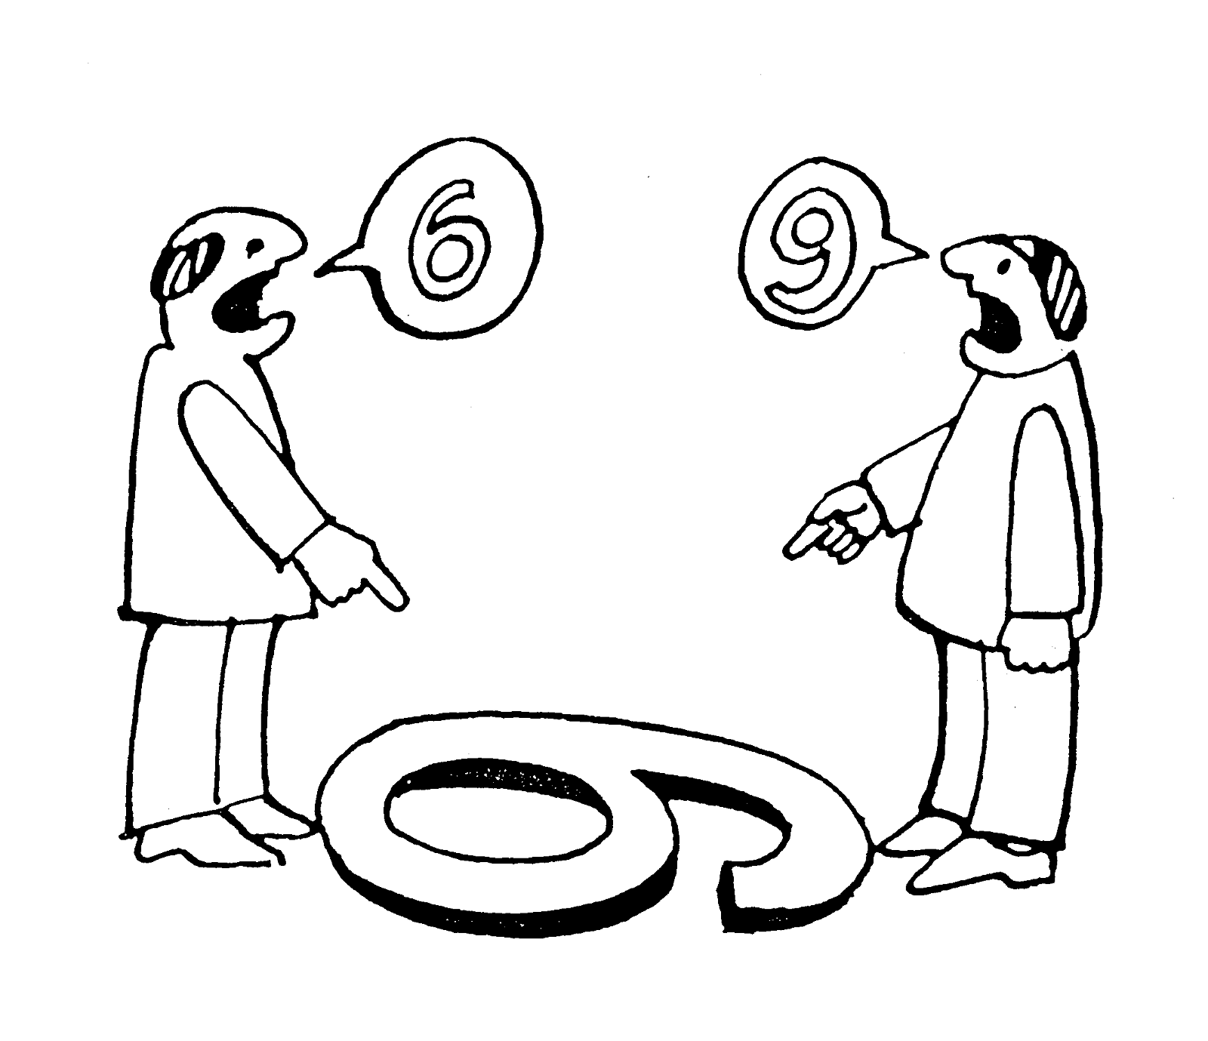
Who is right?
Notes:
„Just because you are right does not mean that I am wrong“
Different ways to interpret facts
Recently saw picture somewhere alse: „One of these people IS wrong, somebody painted a 6 or 9 and they need to orient themselves, see of there are other numbers to align with – maybe there is a driweway or building, maybe they can ask somebody who knows.

Slide 16
UN Convention on Contracts for the International Sale of Goods
„The most successful international document so far“ in unified international sales law
One of the core treaties in international trade (94 countries)
Adopted on 11 April 1980 (in force from 1 January 1988)
Purpose – to provide a uniform and fair regime for contracts for the international sale of goods, increase certainty in commercial exchanges and decrease transaction costs
Careful balance between the interests of the buyer and of the seller (freedom of contract – change of provisions)
Applies to contracts of sale of goods between parties whose places of business are in different states:
when the states are Contracting States; or
when the rules of private international law lead to the application of the law of a Contracting State.
„The greatest influence on the law of worldwide trans-border commerce“
Notes:
a contract for the sale of goods is governed by the law of the country where the seller has his habitual residence, seat or principal place of business (unless the contract is governed by the UN Sales Convention (CISG), but note Art. 4 CISG for the limited scope of the Convention, issues outside the Convention's scope must be determined under the applicable domestic law!),
http://www.tradeready.ca/2016/trade-takeaways/know-important-treaty-signing-international-contracts-united-nations-convention-on-contracts-for-the-international-sale-of-goods/
Why is it relevant?
The contract of sale is the backbone of international trade in all countries, irrespective of their legal tradition or level of economic development. The CISG is therefore considered one of the core international trade law conventions whose universal adoption is desirable.
The CISG is the result of a legislative effort that started at the beginning of the twentieth century. The resulting text provides a careful balance between the interests of the buyer and of the seller. It has also inspired contract law reform at the national level.
The adoption of the CISG provides modern, uniform legislation for the international sale of goods that would apply whenever contracts for the sale of goods are concluded between parties with a place of business in Contracting States. In these cases, the CISG would apply directly, avoiding recourse to rules of private international law to determine the law applicable to the contract, adding significantly to the certainty and predictability of international sales contracts.
Moreover, the CISG may apply to a contract for international sale of goods when the rules of private international law point at the law of a Contracting State as the applicable one, or by virtue of the choice of the contractual parties, regardless of whether their places of business are located in a Contracting State. In this latter case, the CISG provides a neutral body of rules that can be easily accepted in light of its transnational nature and of the wide availability of interpretative materials.
Finally, small and medium-sized enterprises as well as traders located in developing countries typically have reduced access to legal advice when negotiating a contract. Thus, they are more vulnerable to problems caused by inadequate treatment in the contract of issues relating to applicable law. The same enterprises and traders may also be the weaker contractual parties and could have difficulties in ensuring that the contractual balance is kept. Those merchants would therefore derive particular benefit from the default application of the fair and uniform regime of the CISG to contracts falling under its scope.
Key provisions
The CISG governs contracts for the international sales of goods between private businesses, excluding sales to consumers and sales of services, as well as sales of certain specified types of goods. It applies to contracts for sale of goods between parties whose places of business are in different Contracting States, or when the rules of private international law lead to the application of the law of a Contracting State. It may also apply by virtue of the parties' choice. Certain matters relating to the international sales of goods, for instance the validity of the contract and the effect of the contract on the property in the goods sold, fall outside the Convention's scope. The second part of the CISG deals with the formation of the contract, which is concluded by the exchange of offer and acceptance. The third part of the CISG deals with the obligations of the parties to the contract. Obligations of the sellers include delivering goods in conformity with the quantity and quality stipulated in the contract, as well as related documents, and transferring the property in the goods. Obligations of the buyer include payment of the price and taking delivery of the goods. In addition, this part provides common rules regarding remedies for breach of the contract. The aggrieved party may require performance, claim damages or avoid the contract in case of fundamental breach. Additional rules regulate passing of risk, anticipatory breach of contract, damages, and exemption from performance of the contract. Finally, while the CISG allows for freedom of form of the contract, States may lodge a declaration requiring the written form.

Slide 17
UN Convention on the International Sale of Goods
CISG can also be applied by virtue of the choice of the contractual parties, regardless of whether their places of business are located in a Contracting State
Help especially for SME and traders located in developing countries with limited access to legal advice when negotiating a contract
Convention excludes sales of services and certain types of goods because of:
its purpose (i.e. consumer contracts)
its particular nature (i.e. sales by auction)
the nature of the goods (i.e. shares, investment securities, negotiable instruments, money, ships, aircraft or electricity)
Notes:
- Getting a fair contract for parties in developing states can be hard (weaker negotiating position)

Slide 18
UN Convention on the International Sale of Goods
What forms a contract?
Contract is concluded by the exchange of offer and acceptance
What are the obligations of the seller?
Obligations of the seller include delivering goods in conformity with the quantity and quality stipulated in the contract, as well as related documents, and transferring the property in the goods
What are the obligations of the buyer?
Obligations of the buyer include payment of the price and taking delivery of the goods

Slide 19
UN Convention on the International Sale of Goods
What can an aggrieved party do when the contract is breached?
The convention provides common rules regarding remedies for breach of contract. The aggrieved party may require specific performance, claim damages or avoid the contract in case of fundamental breach (Why?)
Additional rules regulate passing of risk, anticipatory breach of contract, damages, and exemption from performance of the contract
Freedom of form of the contract (but States may lodge a declaration requiring the written form)

Slide 20
Dispute Resolution Schemes

Slide 21
Dispute Resolution Schemes
What are the most typical dispute resolution processes?
Any experience with a particular one?

Slide 22
Dispute Resolution Schemes
Negotiation
Mediation
Litigation
Commercial Arbitration
Investment Arbitration
etc. such as?

Slide 23
Dispute Resolution Schemes
Non-binding
Binding
Decision by Disputing Parties
Decision by Third Parties
Alternative Dispute Resolution (ADR)
Early Neutral Expert Evaluation
Litigation
Avoidance
Mediation
Arbitration
Conciliation
Peer Review Panel
Facilitated Negotiation
Unassisted Negotiation
Notes:
Avoidance – not confronting the issues at hand (put off)
Negotiation = 2 parties with competing or conflicting interests, working towards agreement hw to cooperate
Early neutralexpert evaluation – use of industry expert or top practicing professional to function as independent reviewer and conduct unbiased evaluation of the burning points of matter at stake.
Mediation – independent thurd party mediator helps parties to reach settlement, decisions made by parties
Conciliation (vyrovnání) – mediator is more active, puts suggestions of compromise, otherwise similar to mediation, it‘s structured to bring disputing parties to acceptable agreement through concessions
Peer review panel =
Peers such as managers are placed in a panel to evalua and resolve matters pertaining to their colleagues
Ombudsman
Binding - ““Binding” is a term used in the legal field to describe an agreement between two parties that is enforceable by law. When one party breaks the terms of the agreement, the other party can take legal action to enforce the agreement.
https://www.slideshare.net/ezendu/dispute-resolution-methods

Slide 24
Communication channels
Facebook for communication, forming teams, etc?
e-mail:
vagnerova.paja@gmail.com

