Slide 1
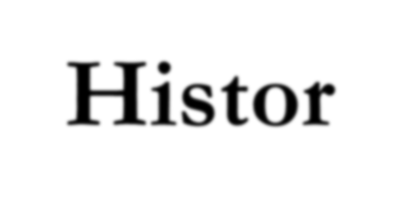
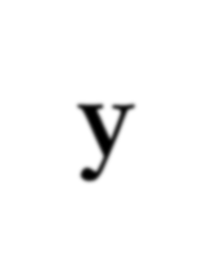
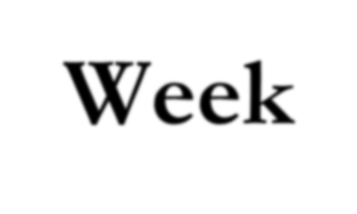
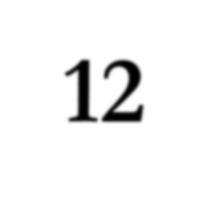
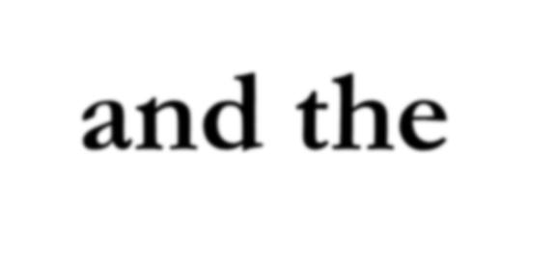
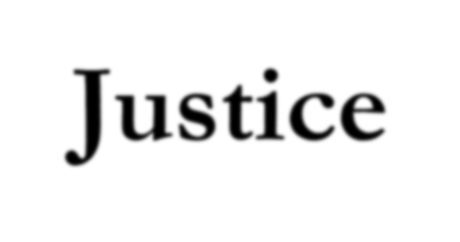
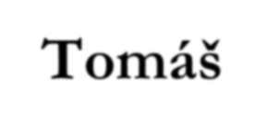
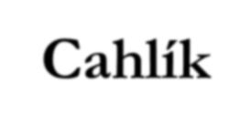
History of Economic Thought
Week 10 - Seminar
General Economic Equilibrium - from Triumph to Crisis.
Welfare Economics and the Economic Theories of Justice
Tomáš Cahlík

Slide 2
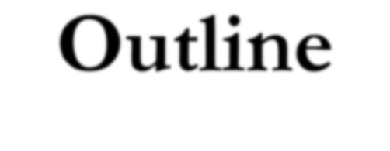
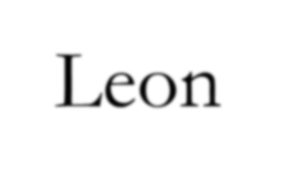
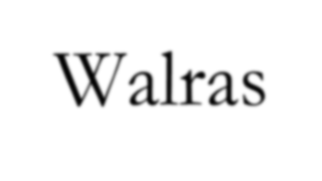
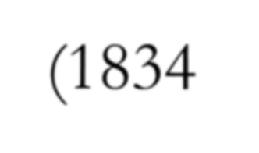
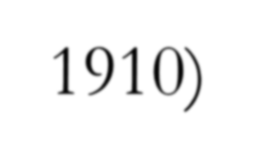
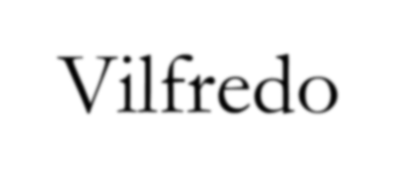
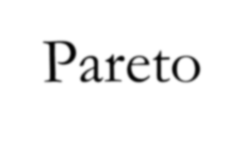
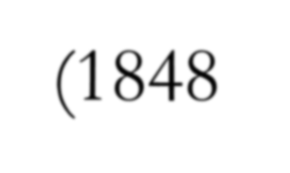
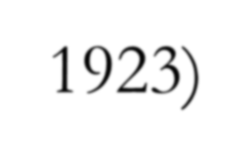
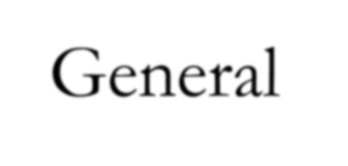
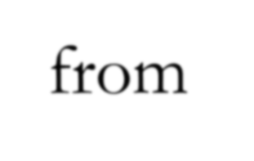
Outline
Leon Walras (1834 – 1910)
Vilfredo Pareto (1848 – 1923)
General Economic Equilibrium - from Triumph to Crisis.
Welfare Economics and the Economic Theories of Justice.

Slide 3
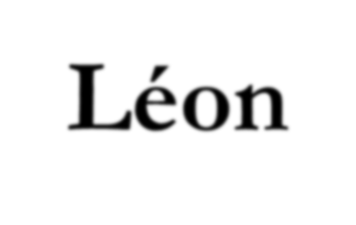
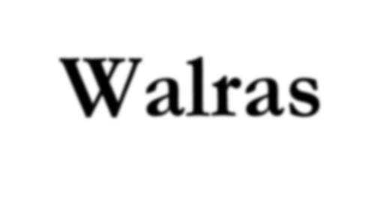
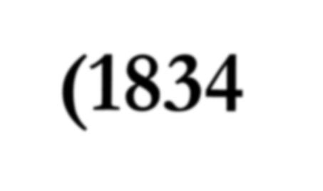
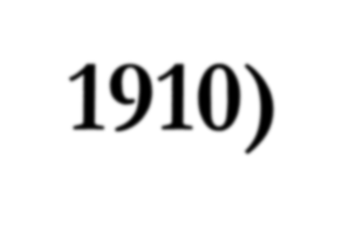
Léon Walras (1834 – 1910)
One of three fathers of marginalist revolution in the 70ies of the 19th century
He worked on general equilibrium – equilibrium between demand and supply on all markets
His model is formed by a system of equations:
Variables:
n productive services
m consumer goods
n prices of productive services
(m-1) prices of consumer goods (one consumer good is the „numeraire“ with price 1)
(2m+2n-1) total number of variables ((n+m) quantities of productive services and consumer goods, (n+m-1) prices of productive services and consumer goods)

Slide 4
Léon Walras (1834 – 1910)
Equations:
n markets for productive services, n+n equations for supply and demand of productive services
m markets for consumer goods, m+m equations for supply and demand of consumer goods
Walras´s law: If all markets but one are in equilibrium, then the last market must be in equilibrium, too. That is why just 2m + 2n -1 equations are independent.
So we have 2m+2n-1 independent equations for 2m+2n-1 variables. It can have a solution, so equilibrium can exist, but not necessarily.

Slide 5
Léon Walras (1834 – 1910)
Mathematical problems:
Existence of equilibrium
Uniqueness and stability of equilibrium
Other problems
Auctioneer amd process of tatonement: No exchanges occur before the auctioneer cries out correct prices, i.e. prices that clear simultaneously all markets.
With these prices, profit is zero, so no incentive exists for enterpreneurs. Why do they take part in economic activities?
Walras´s law: If all markets but one are in equilibrium, then the last market must be in equilibrium, too.

Slide 6
Léon Walras (1834 – 1910)
More that 100 years of research activity were centered in finding solutions to these problems. Other general equilibrium models have been created and worked with, mathematical problems are similar an all of those models.

Slide 7
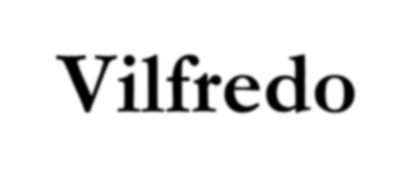
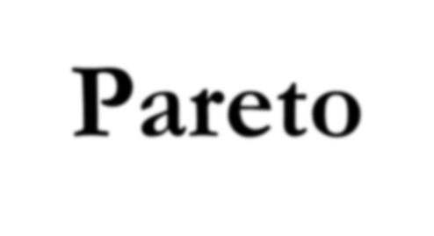
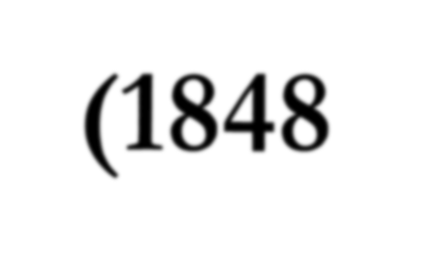
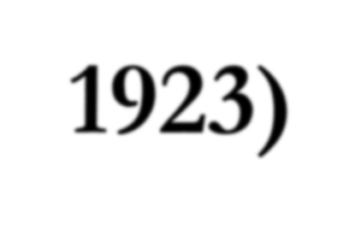
Vilfredo Pareto (1848 – 1923)
Lausanne chair in economics since 1892 – after Walras
Application of further mathematical tools to the general equilibrium approach developed by Walras
Pareto´s law for personal income distribution (illustration in Netlogo)
Abandonment of the cardinal notion of utility in favor of an ordinal notion (Irving Fisher before him)
Notion of the Pareto optimum (Edgeworth developed and named this after Pareto)

Slide 8
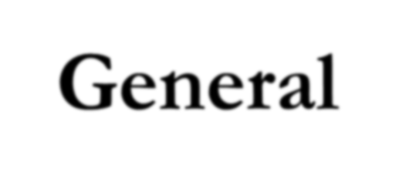
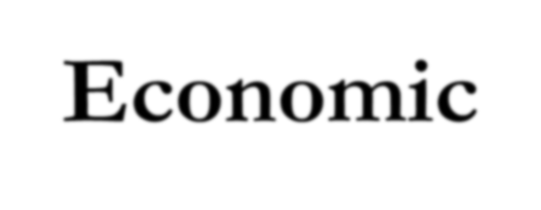
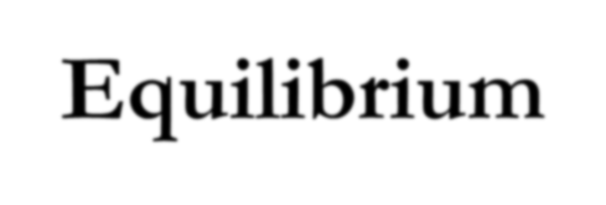
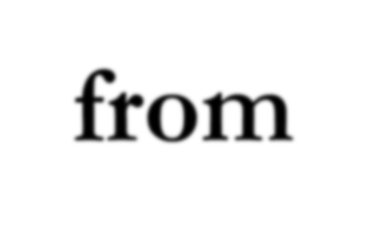
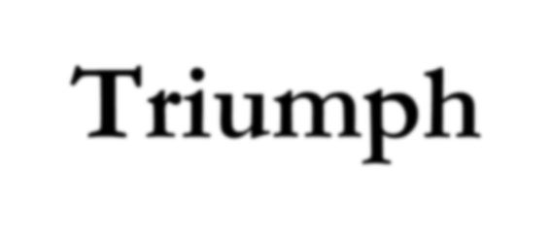
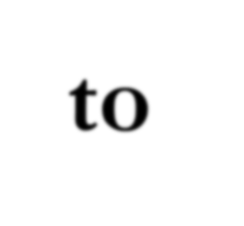
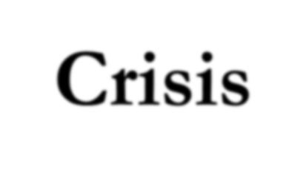
General Economic Equilibrium – from Triumph to Crisis
Problem of existence, uniqueness and stability:
Developments in mathematics have been allowing to work on these problems
Exodus of European thinkers to the USA before WW2
Samuelson
1941 „The Stability of Equilibrium, Comparative Statics and Dynamics“
1947 „Foundations of Economic Analysis“
Reformulation of „tatonement“ with the use of differential equation

Slide 9
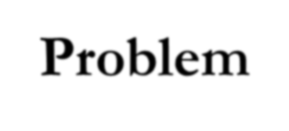
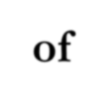
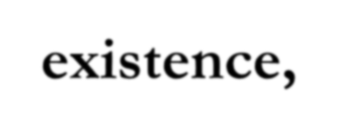
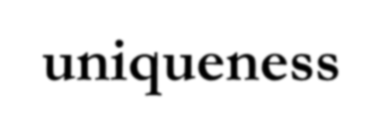
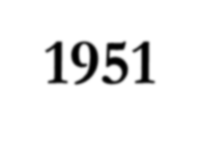
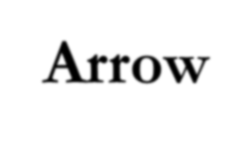
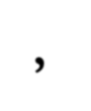
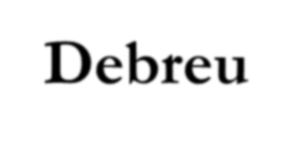
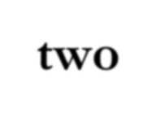
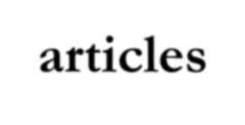
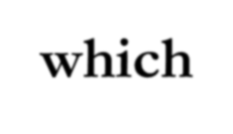
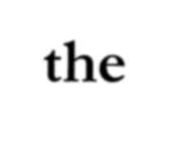
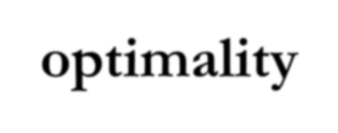
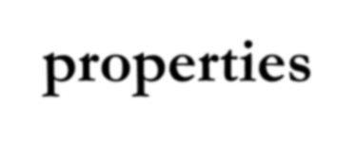
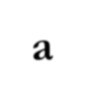
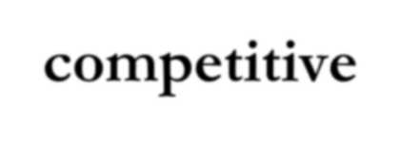
General Economic Equilibrium – from Triumph to Crisis
Problem of existence, uniqueness and stability:
1951 Arrow, Debreu: two articles which demonstrated the optimality properties of a competitive equilibrium
1952 Arrow, Debreu, McKenzie at a meeting of Econometric society: demonstration of the existence of equilibrium in their models
1959 Debreu: proof of existence in another model
1958 Arrow, Hurwitz „On the Stability of
Competitive Equilibrium“
1960 Herbert Scarf „Some Examples of Global Instability of the Competitive Equilibrium“

Slide 10
General Economic Equilibrium – from Triumph to Crisis
Problem of existence, uniqueness and stability:
Ongoing research has not lead to persuasive results
with at least minimally realistic assumptions

Slide 11
General Economic Equilibrium – from Triumph to Crisis
General Criticism of any GE model:
It is not realistic
It has a weak explanatory and forecasting power
Ideological criticism: GE model is a good representation of reality for the ruling class, it shows that the general harmony existing in the general equilibrium is possible

Slide 12
General Economic Equilibrium – from Triumph to Crisis
Arguments protecting GE models:
Research moves forward, so the research programme may be progressive in the end
GE research inspires research in specific theoretical fields and in forecasting
GE model represents a general framework that keeps many theoretical pieces together
It can be used as a taxonomic instrument

Slide 13
General Economic Equilibrium – from Triumph to Crisis
Arguments protecting GE models:
Why should the GE model describe anything? A pure theory is not an imitation, description or reflection of reality but a parable
Is the GE model relevant? Areas, in which it is not relevant, ought to be tackled with other disciplines. It is relevant in tackling the problem of efficient allocation of scarce resources. Who decides which problems are relevant?

Slide 14
General Economic Equilibrium – from Triumph to Crisis
Decisive Criticism of the GE model – through inconsistency
For consistency, it would be necessary to demonstrate that in the individualistic competitive framework the market is really able to lead the economy towards a state of equilibrium
It has been prooved that the behaviour of individuals is not sufficient to give the invisible hand the strength it needs to lead the market towards equilibrium. Strong hypotheses on behaviour of certain aggregate variables are necessary to lead the economy to a stable equilibrium

Slide 15
General Economic Equilibrium – from Triumph to Crisis
Reactions to the Decisive Criticism of the GE model
GE model describes a possible ideal world, even analysing ideal worlds can bring some insight to the functioning of the real world
Shift of activity to dynamic analysis.
Complex Economic Dynamics – use of nonlinear differential and difference equations, sequential approaches – analysis of a sequence of states of the economy
Analysis of temporary equilibriums, sequential approaches to a sequence of equilibriums
DSGE (Dynamic Stochastic General Equilibrium) models
Shift of activity to other approaches and development of those approaches, one effect is fragmentation of economics

Slide 16
New Welfare Economics and the Economic Theories of Justice
Two fundamental Welfare Theorems:
A competitive equilibrium – without market failures - is not Pareto-dominated by any feasible social allocation.
Proof: Arrow, Debreu – 1951
Given any desired Paretian allocation, it is always possible – without market failures – to distribute the initial endowments among individuals in such a manner that the Walrasian equilibrium after exchanges will be that desired Paretian allocation.
Proof: Arrow, Debreu

Slide 17
New Welfare Economics and the Economic Theories of Justice
Usual use of the second theorem: it sanctions the separation between the efficiency problem and the distributive-justice problem. In other words: the initial endowmens is not an economic problem, economic problem is the efficiency of the market process.
Criticism:
Dasgupta 1986 – „Positive Freedom, Markets and the Welfare State“
Paradox: A central authority with knowledge how to distribute initial endowments to come to a Paretian allocation could come to that allocation dirrectly without market exchanges
Walrasian equilibrium considered in Welfare Theorems must be unique and stable, neither has been prooved.

Slide 18
New Welfare Economics and the Economic Theories of Justice
Market failures: some assumptions for the validity of welfare theorems are not fulfilled:
Externalities:
Solution 1: Pigou – corrective measures – corrective taxations
and subsidies, further elaborated by Samuelson in the 40ies.
Solution 2: Coase (University of Chicago Law School) 1960
„The Problem of Social Costs“ - without transaction costs, market can solve externalities on its own.
Commons:
Hardin 1968 „The Tragedy of the Commons“
To do what you want and to get what you want is not always compatible whenever social interactions are present
Solution 1: Albert Hirschman and Amartya Sen either collective
action or adding benevolence to the individual moral code
Solution 2: Chicago school (in the sense of an economics school) - assignment of private property rights

Slide 19
New Welfare Economics and the Economic Theories of Justice
Market failures: some assumptions for two welfare theorems are not fulfilled:
Public Goods:
Problem of free rider: Wicksell – in the Swedish
cultural area – did not realize the free rider problem
Adding benevolence to the individual moral code
Information Asymmetry:
George Ackerlof 1970 „The Market for Lemons“
Solution 1: Adding benevolence to the individual moral code
Solution 2: Screening and monitoring - Linked with the increase of transaction costs

Slide 20
New Welfare Economics and the Economic Theories of Justice
Market failures: Which research programmes have they motivated?
New Institutional Economics – with its stress on the role of transaction costs
Theory of social choice (nowadays, it is the Theory of public choice)
Return of ethics to economics

Slide 21
New Welfare Economics and the Economic Theories of Justice
Theory of Social Choice
With increasing public sector, problems of delivery of public goods started to be very relevant and very conflicting
Arrow 1951 book „Collective Choice and Individual Values“
Arrow´s Impossibility Theorem
If we leave the assumption of cardinal utility, aggregating individual preferences can lead to inconsistencies
Knut Wicksell, unanimous and majority voting
Only unanimous voting leads to efficient outcomes
James Buchanan, Public Choice Theory and Constitutional Economics

Slide 22
New Welfare Economics and the Economic Theories of Justice
Return of ethics to economics
Sen 1970 „Collective Choice and Social Welfare“
Criticism of the „ordinaly utilitarian“ thinking behind Arrow´s analysis – Why are individuals an ultimate authority?
Arthur Ocun 1975 „Equality and Efficiency: The Big Trade-Off“
Following the aim of equality, efficiency can be decreased, „the pie can become smaller“

Slide 23
New Welfare Economics and the Economic Theories of Justice
Return of ethics to economics
More philosophical inputs to the discussion:
John Rawls 1971 „A Theory of justice“
Robert Nozick 1974 „Anarchy, State and Utopia“
Hayek 1960 „The Constitution of Liberty“
Sen 1973 „On Economic Inequality“

